Slide 1

JYS Christmas Raffle
2020

Slide 2
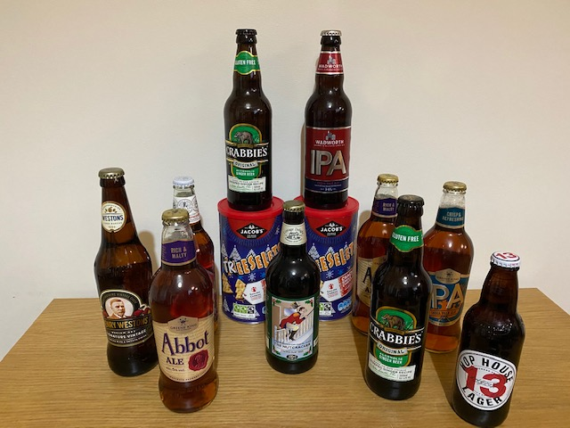
1 – The Beer Bundle

Slide 3
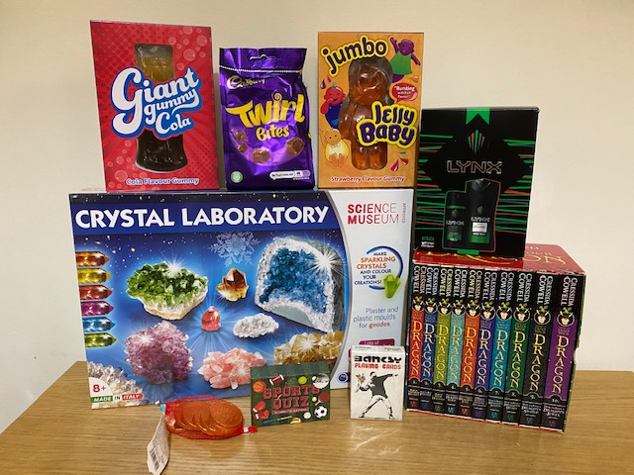
2 – Older Kids’ Bundle

Slide 4
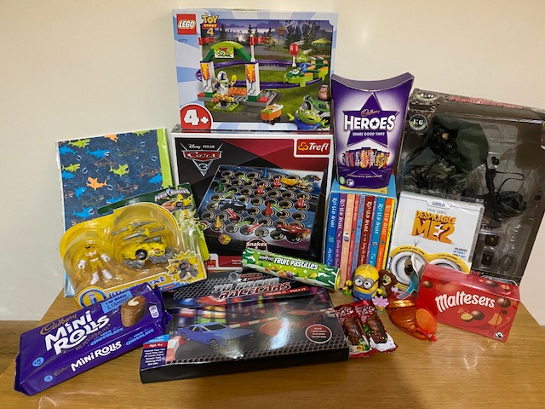
3 – Infants’ Bundle

Slide 5
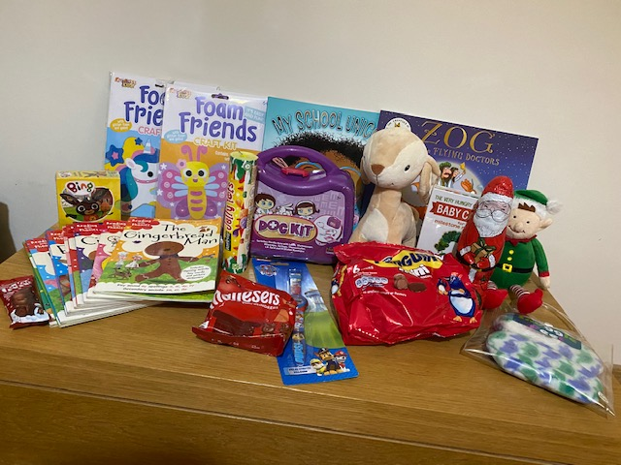
4 – Young Ones’ Bundle
(plus “Vetch phone” not in the photo)

Slide 6
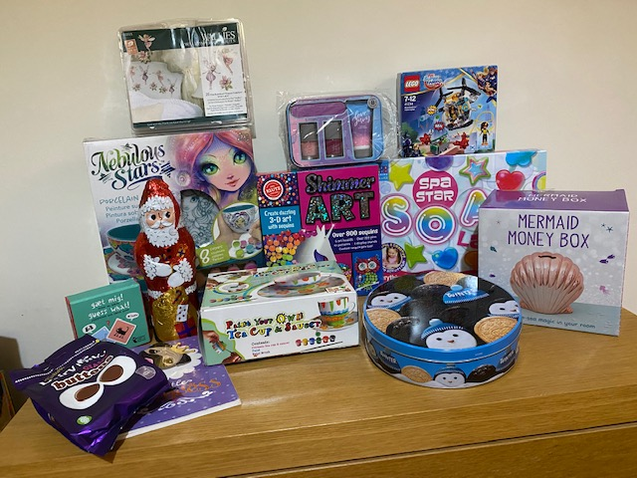
5 – The Crafty One

Slide 7
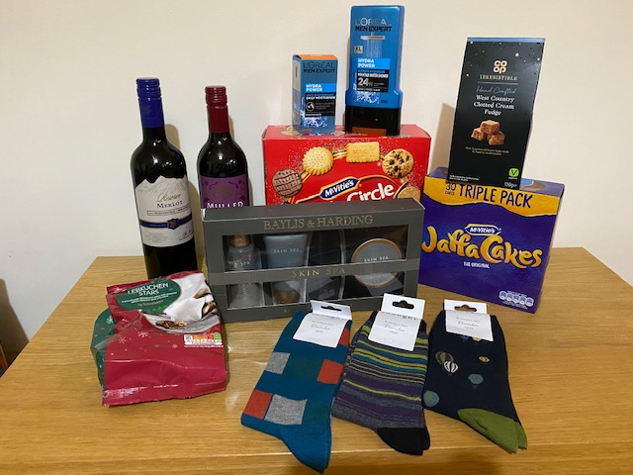
6 – Men’s Bundle

Slide 8
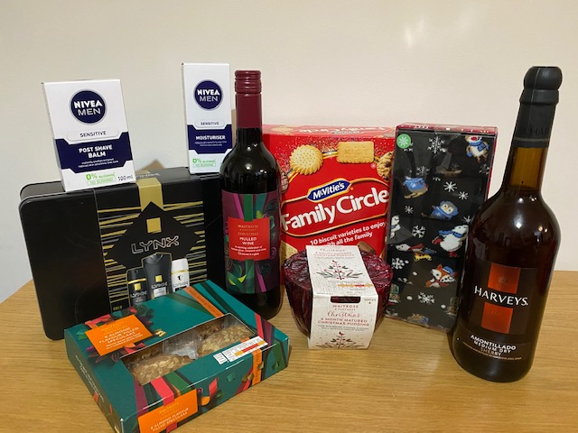
7 – Presents for Adults

Slide 9
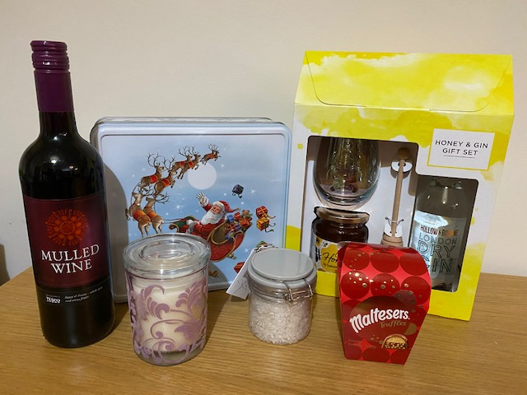
8 – Treat Bundle

Slide 10
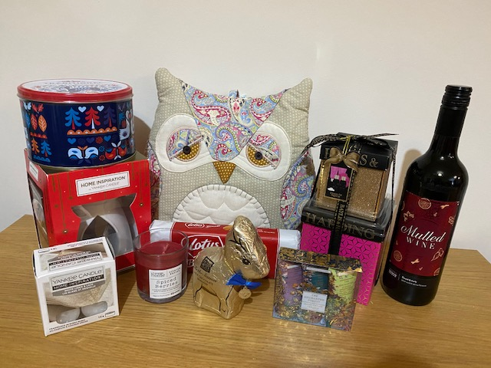
9 - Relaxation Bundle

Slide 11
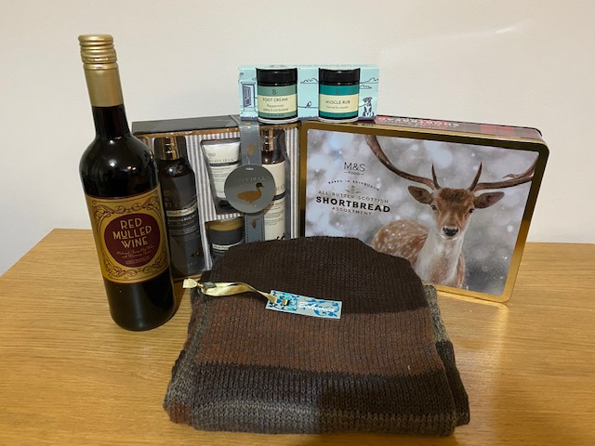
10 – Winter Bundle

Slide 12
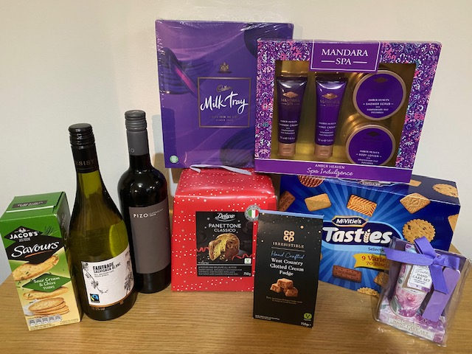
11 – Sweet Treats

Slide 13
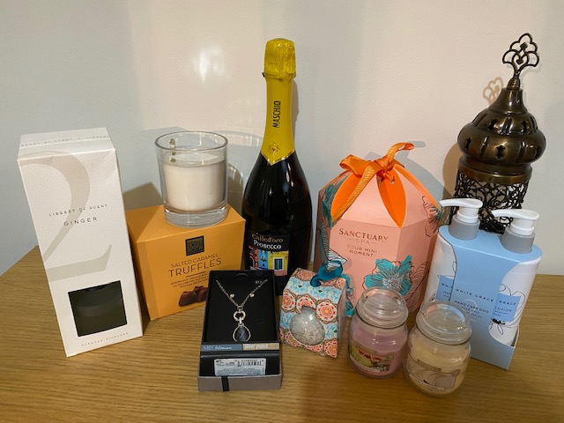
12 – Gift Bundle

Slide 14
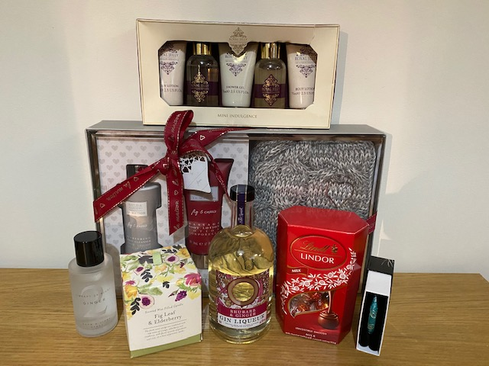
13 – Time Out Bundle

Slide 15
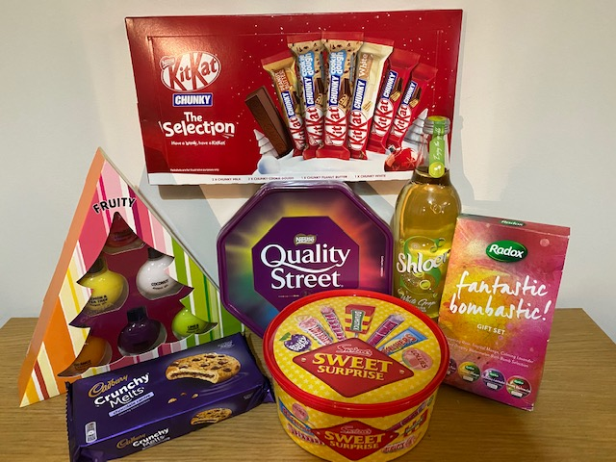
14 – Kids’ Pamper Bundle

Slide 16
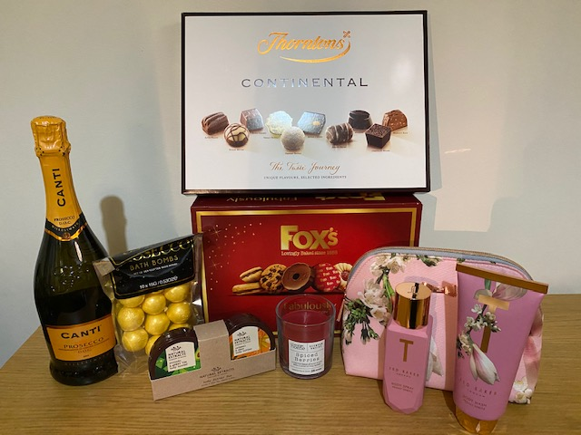
15 – “Bubbles” Bundle

Slide 17
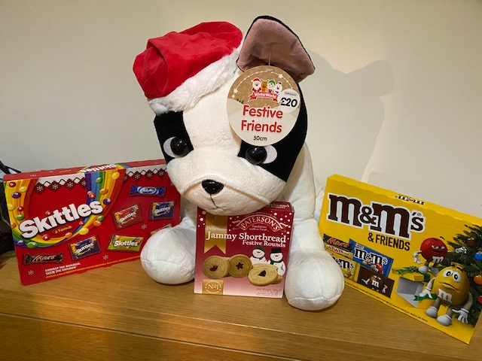
16- The “Big Dog” Bundle

Slide 18
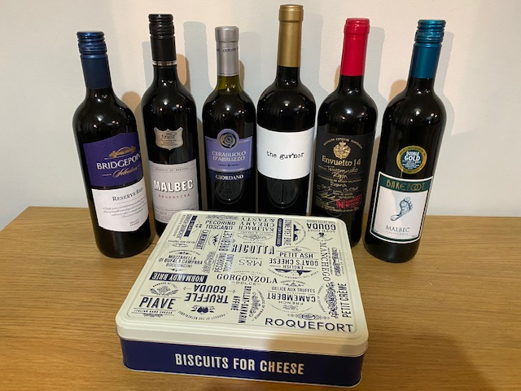
17 – The Reds

Slide 19
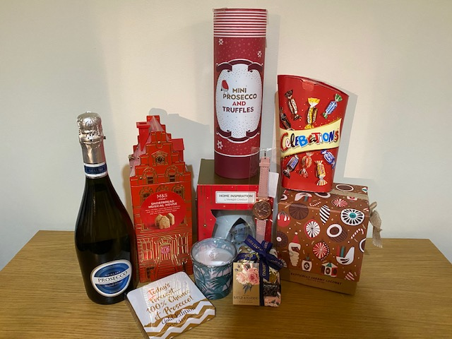
18 – Prosecco and Treats

Slide 20
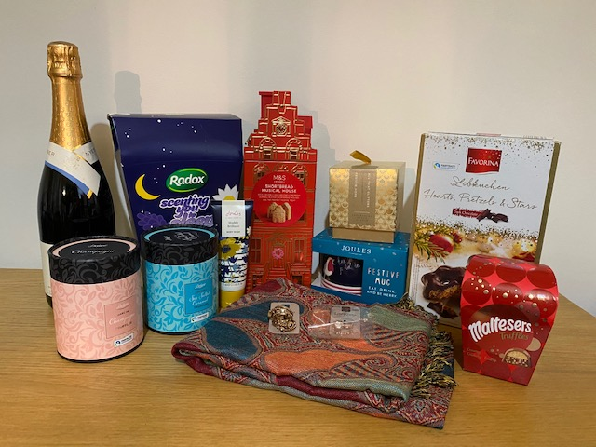
19 – One for a night in

Slide 21
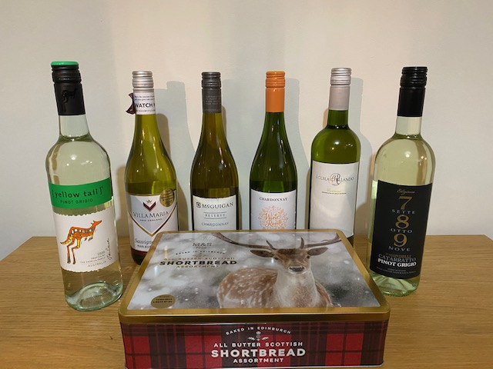
20 – The Whites

Slide 22
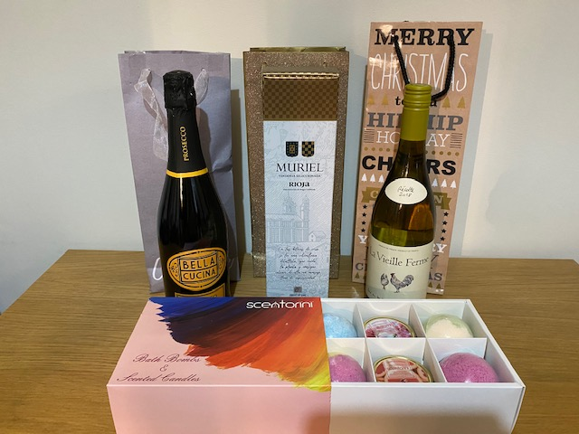
21 – The “Posh” One

Slide 23
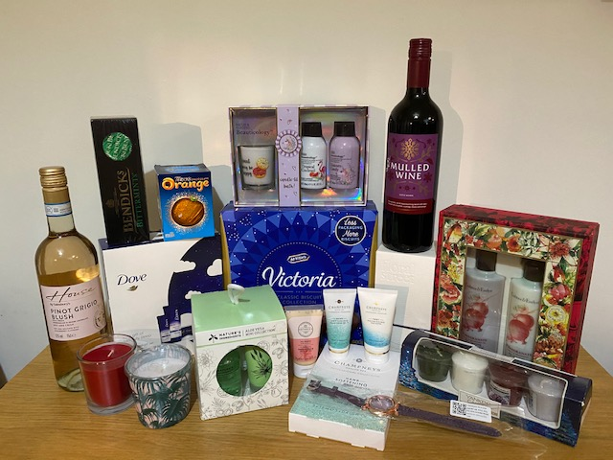
22 – Pamper Night

Slide 24
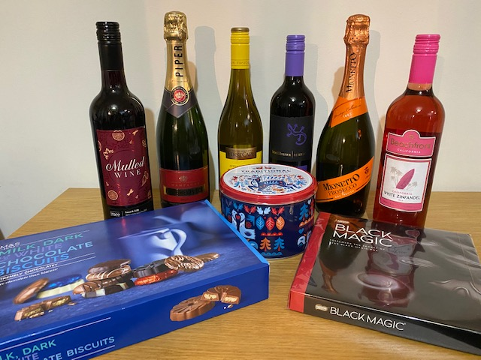
23 – A Little Bit of Everything

Slide 25
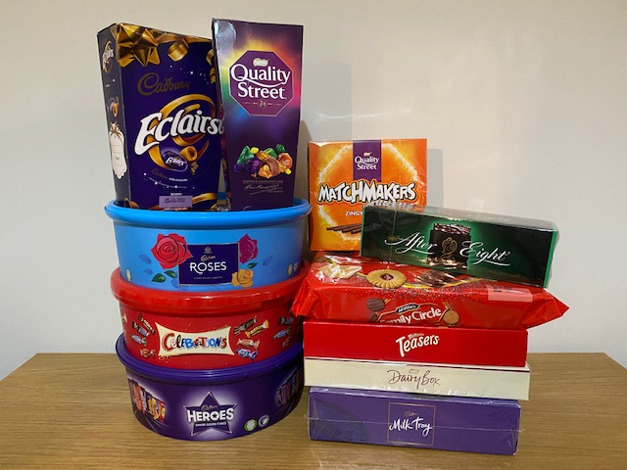
24 – The BIG Sweet Bundle

Slide 26
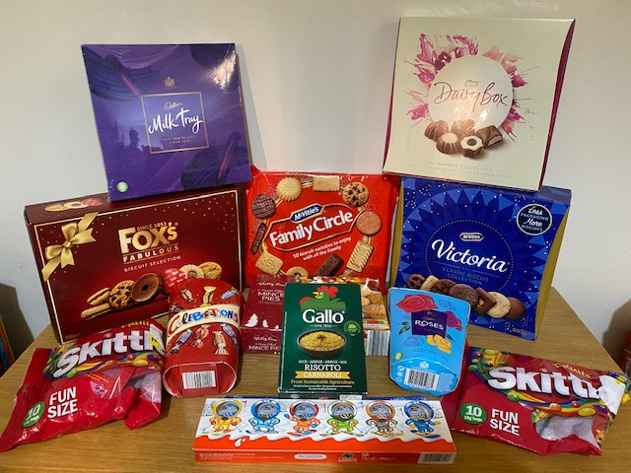
25 – The Chocolate and Biscuit Bundle

Slide 27
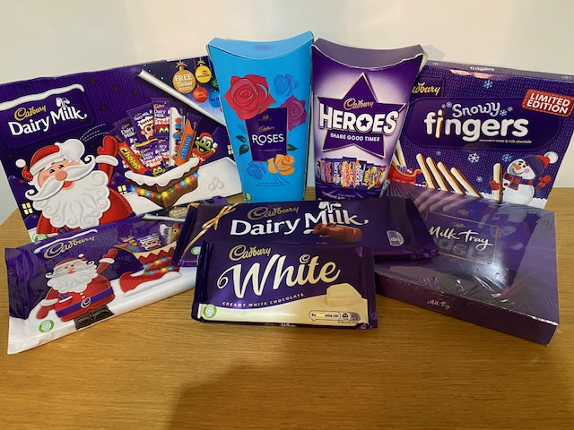
26 – The Cadburys’ Bundle

Slide 28
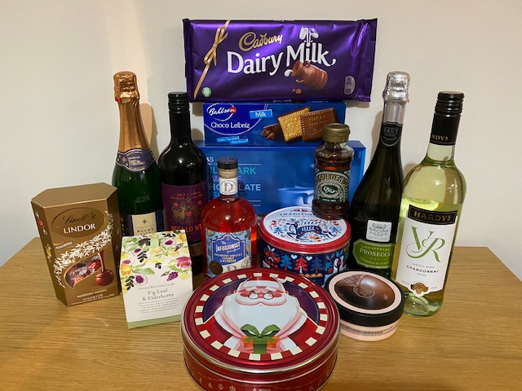
27 – Gin and Treats

Slide 29
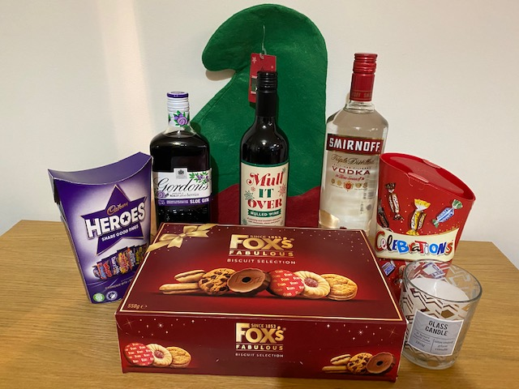
28 – Christmas Spirit Bundle

Slide 30
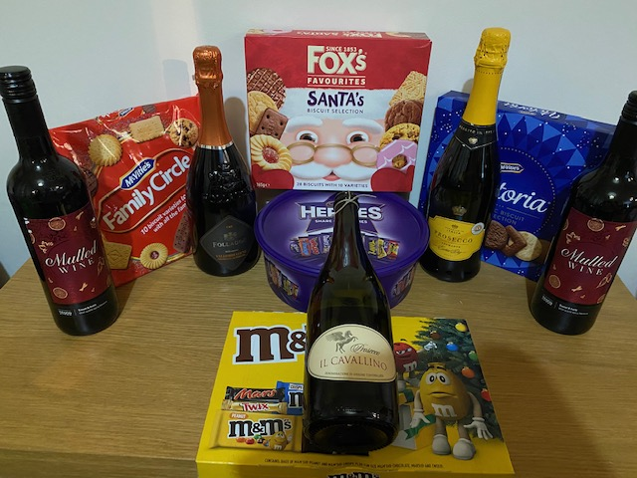
29 – Something for all the family

Slide 31
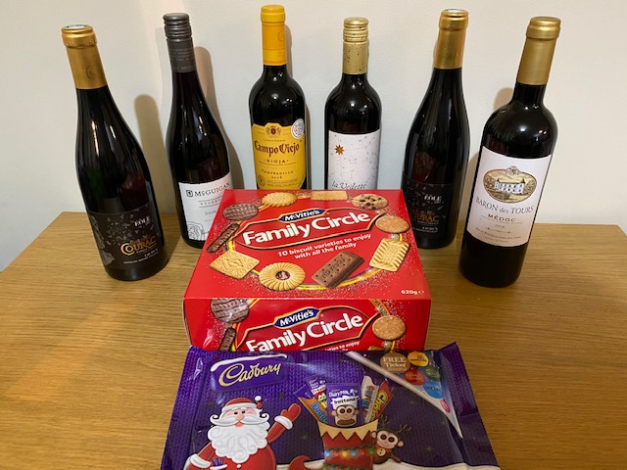
30 – The Final Reds

Slide 32
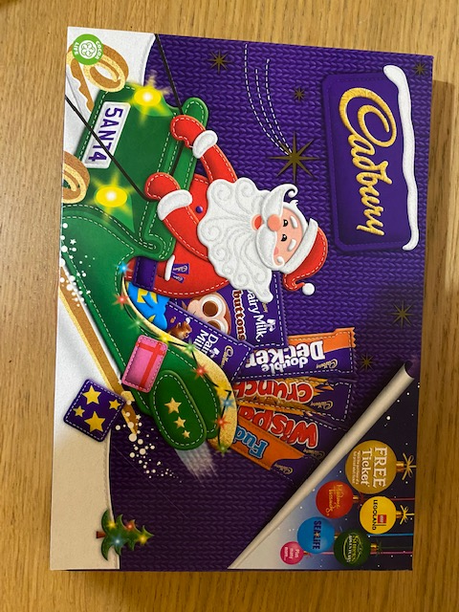
Selection Boxes x 7 of these

Slide 33
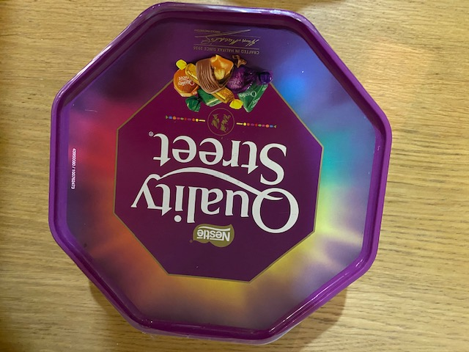
Quality Street Boxes x 4 of these

Slide 34
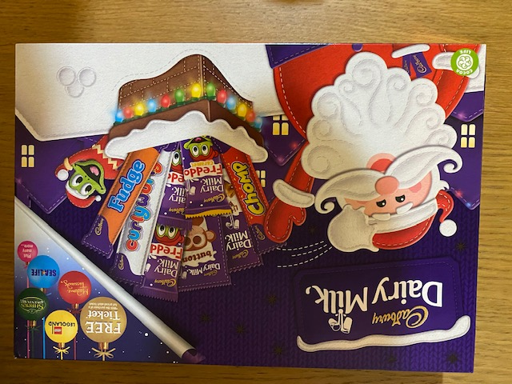
Freddies’ Boxes x 2 of these

Slide 35
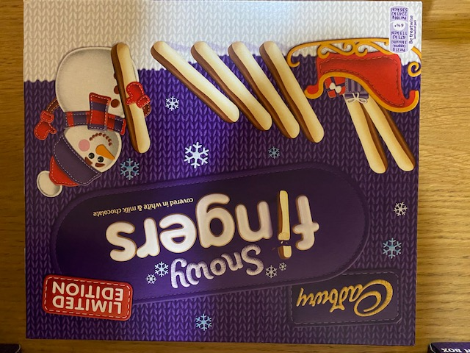
Cadburys Fingers x 3 of these

Slide 36
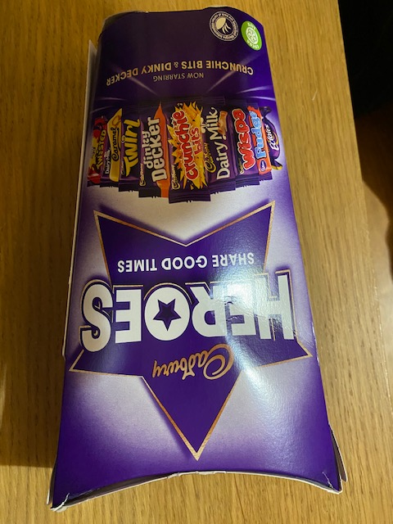
Cadburys Heroes x 4 of these

Slide 37
Thank you for your support

