Slide 1
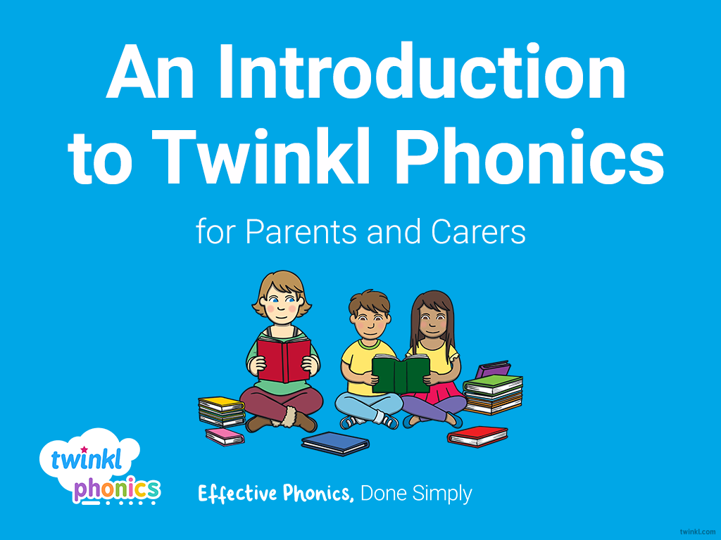

Slide 2
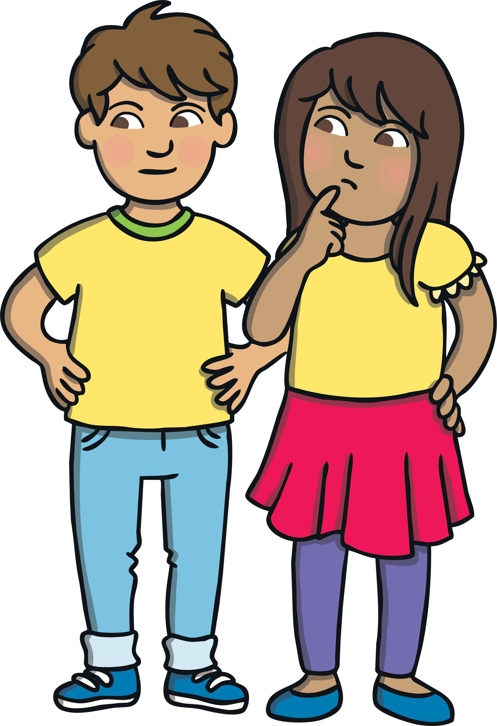
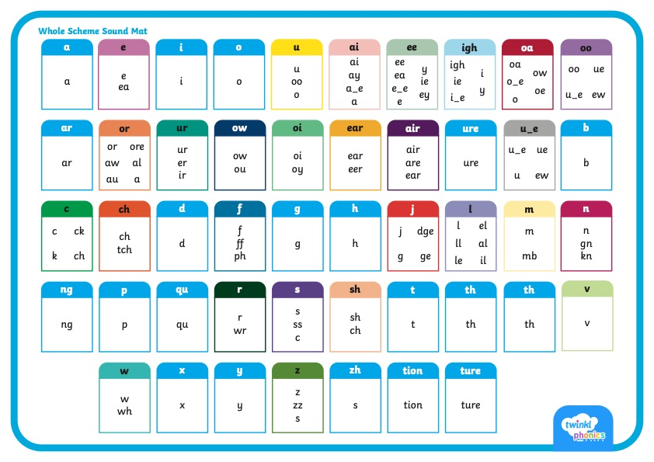
      Did You Know…?
There are 26 letters in the alphabet but there are 44 sounds and over 100 different ways of spelling them.
This is why English is one of the most complex languages to learn!

Slide 3
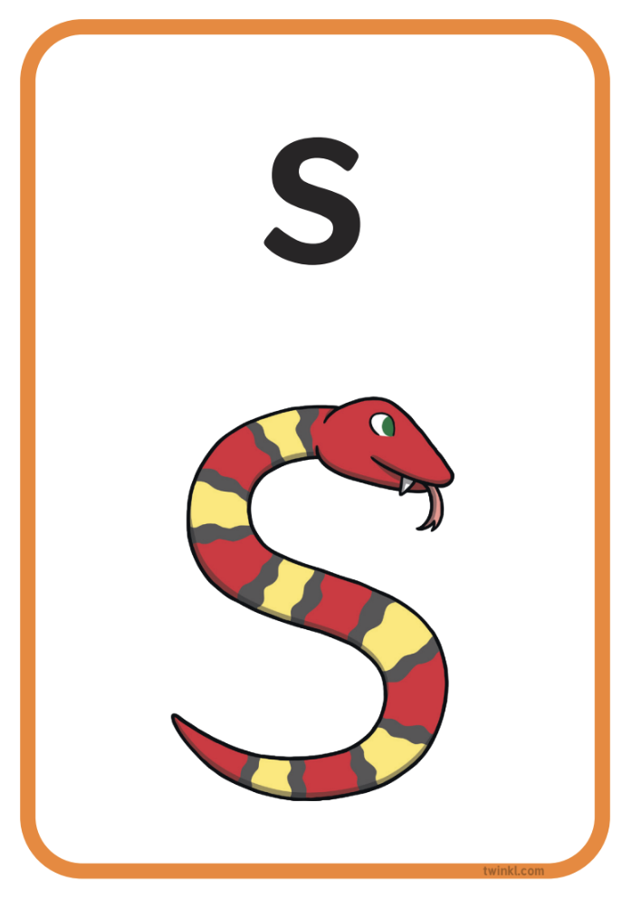
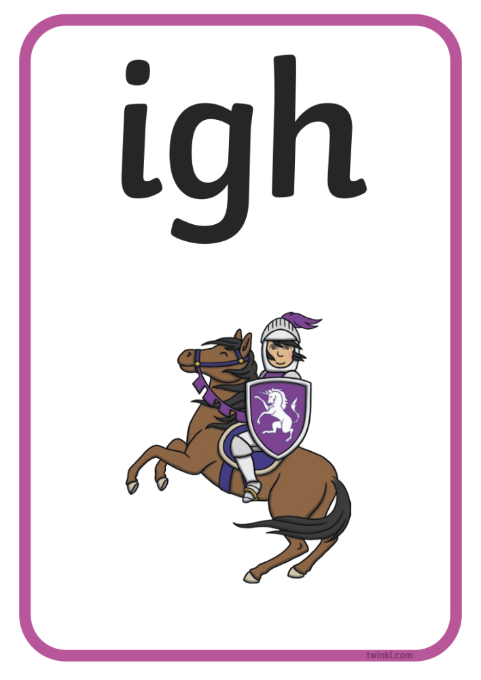
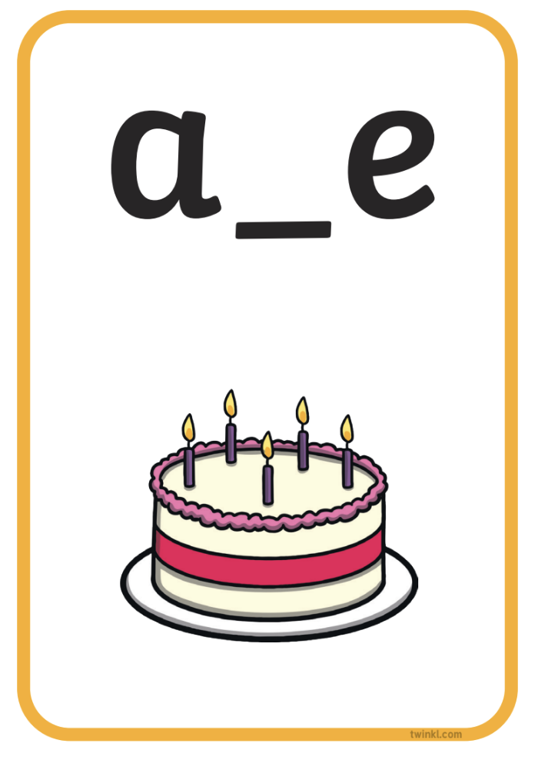


Phonics Terminology
Here is some of the terminology you might hear as your children begin to learn phonics.
Phoneme | the smallest unit of sound in words
Grapheme | the written representation of a sound
GPC (Grapheme-Phoneme Correspondence) | being able to match a phoneme with the correct grapheme and vice versa
Blending | joining individual speech sounds together to read a word
Segmenting | breaking down words into individual speech sounds to spell a word
Digraph | two letters making one sound e.g. ‘sh’
Trigraph | three letters making one sound e.g. ‘igh’
Split Digraph | two letters making one sound which are divided by a consonant e.g. the i_e sound in the word ‘side’
Tricky/Common Exception Words | words that are not fully decodable such as ‘the’ and ‘was’
Sound buttons | circles or spots that can be written underneath a sound to support reading
Sound bars | lines that can be written underneath digraphs or trigraphs to show that the letters make one sound
Mnemonic | a visual prompt to help children remember a sound

Slide 4
      What Is Synthetic Phonics?
Synthetic phonics is a method of teaching reading and writing, in which words are broken up into their smallest units of sound or ‘phonemes’.
Children learn to associate a written letter or group of letters, known as ‘graphemes’, with each phoneme.
Sounds are then joined or ‘blended’ together into words for reading or, conversely, whole words are broken down or ‘segmented’ into their sounds for writing.
It is the UK’s most preferred method of teaching phonics.
Sounds are taught in a prescribed order starting with s, a, t, p, i, n, as this allows for the most words to be made from the start, such as ‘sat,’ ‘tap’ and ‘pin’.

Slide 5
      What Are the Benefits of Synthetic Phonics?
Children progress through the stages as they are ready.
Planning ensures progression and coverage.
Children can attempt new words working from sounds alone.
Reading and writing become practices that are developed hand in hand.

Slide 6

      What Is Taught and When?
Twinkl Phonics Level | Number of Teaching Weeks | Recommended Year Group (UK schools) | Age of Children
Level 1 | 36 | Nursery/Preschool | 3-4 years
Level 2 | 7 | Reception | 4-5 years
Level 3 | 12 | Reception | 4-5 years
Level 4 | 5 | Reception | 4-5 years
Level 5 | 30 | Year 1 | 5-6 years
Level 6 | 30 | Year 2 | 6-7 years
Level 1 continues to be taught alongside the other levels.
This is just an overview. We understand that every child progresses at their own pace.

Slide 7
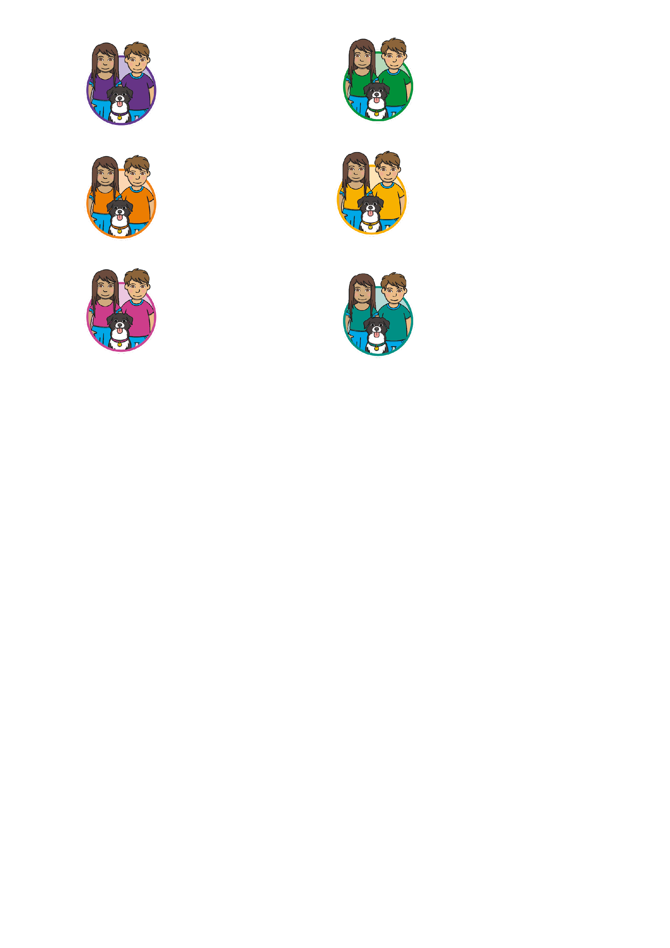
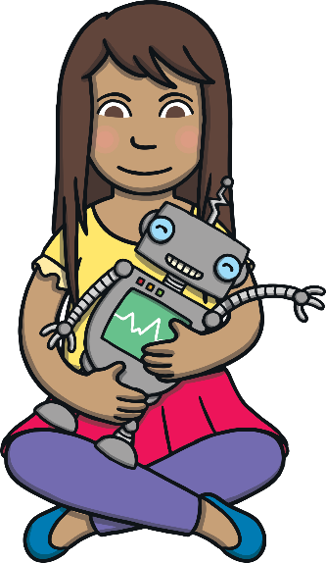
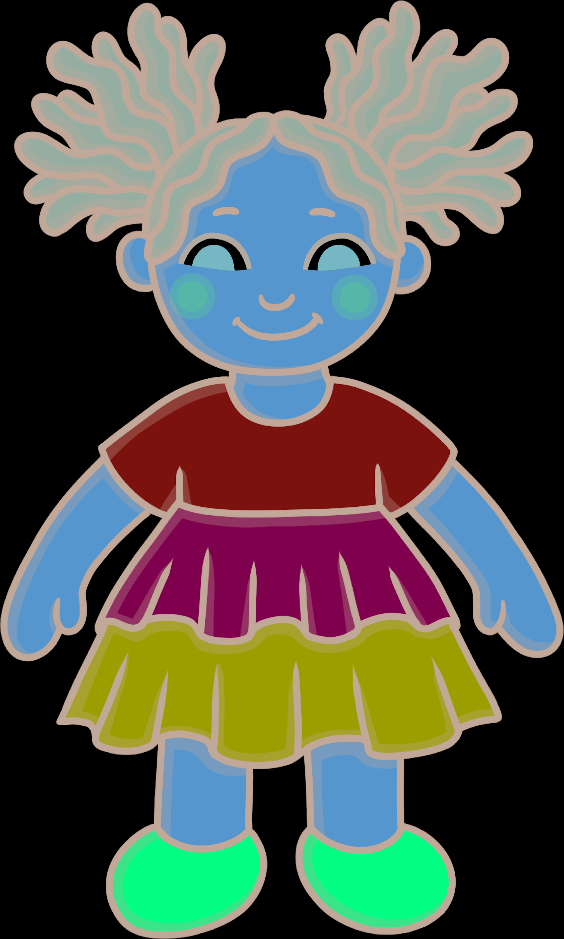
      Level 1
Level 1 is taught in Nursery/Preschool.
By the end of Level 1, children will have had the opportunities to:
listen attentively;
enlarge their vocabulary;
speak confidently to adults and other children;
discriminate different sounds including phonemes;
reproduce audibly the phonemes they hear in words;
orally segment words into phonemes.
These learning opportunities are presented through 7 Aspects.

Slide 8
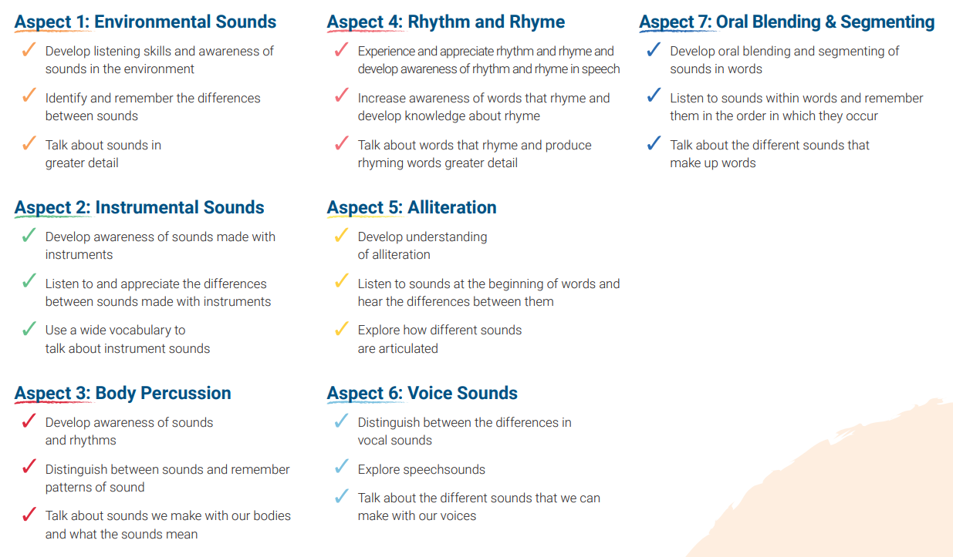
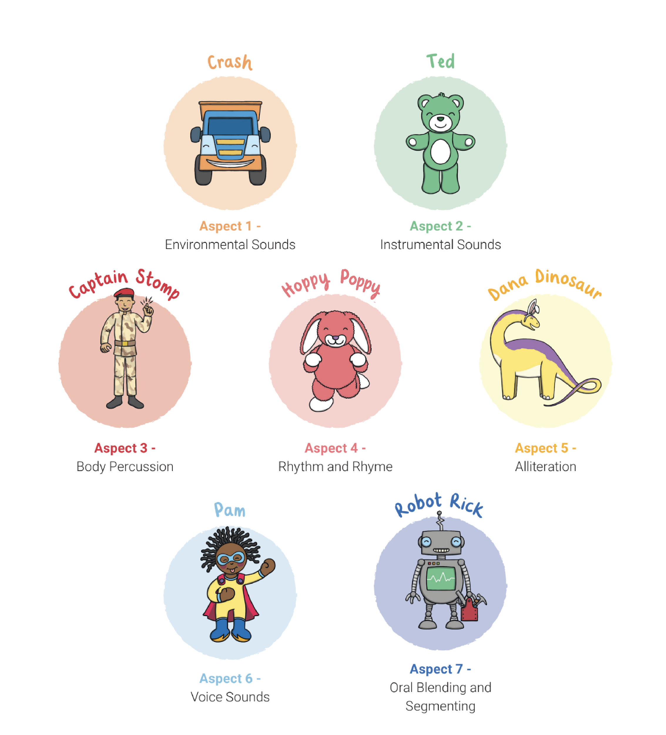
      What Are the 7 Aspects of Level 1?

Slide 9
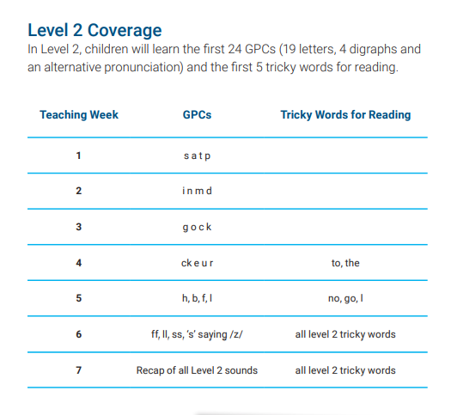
      Level 2
Level 2 is taught in Reception.
By the end of Level 2, children will have had the opportunities to:
identify the phoneme when shown any Level 2 grapheme;
identify any Level 2 grapheme when they hear the phoneme;
orally blend and segment CVC words such as, ‘sat’ and ‘pat’;
blend sounds to read VC words such as, ‘if’, ‘am’, ‘on’ and ‘up’;
segment VC words into their sounds to spell them (using magnetic letters);
read the tricky words (words that cannot be sounded out): the, to, I, no, go.

Slide 10
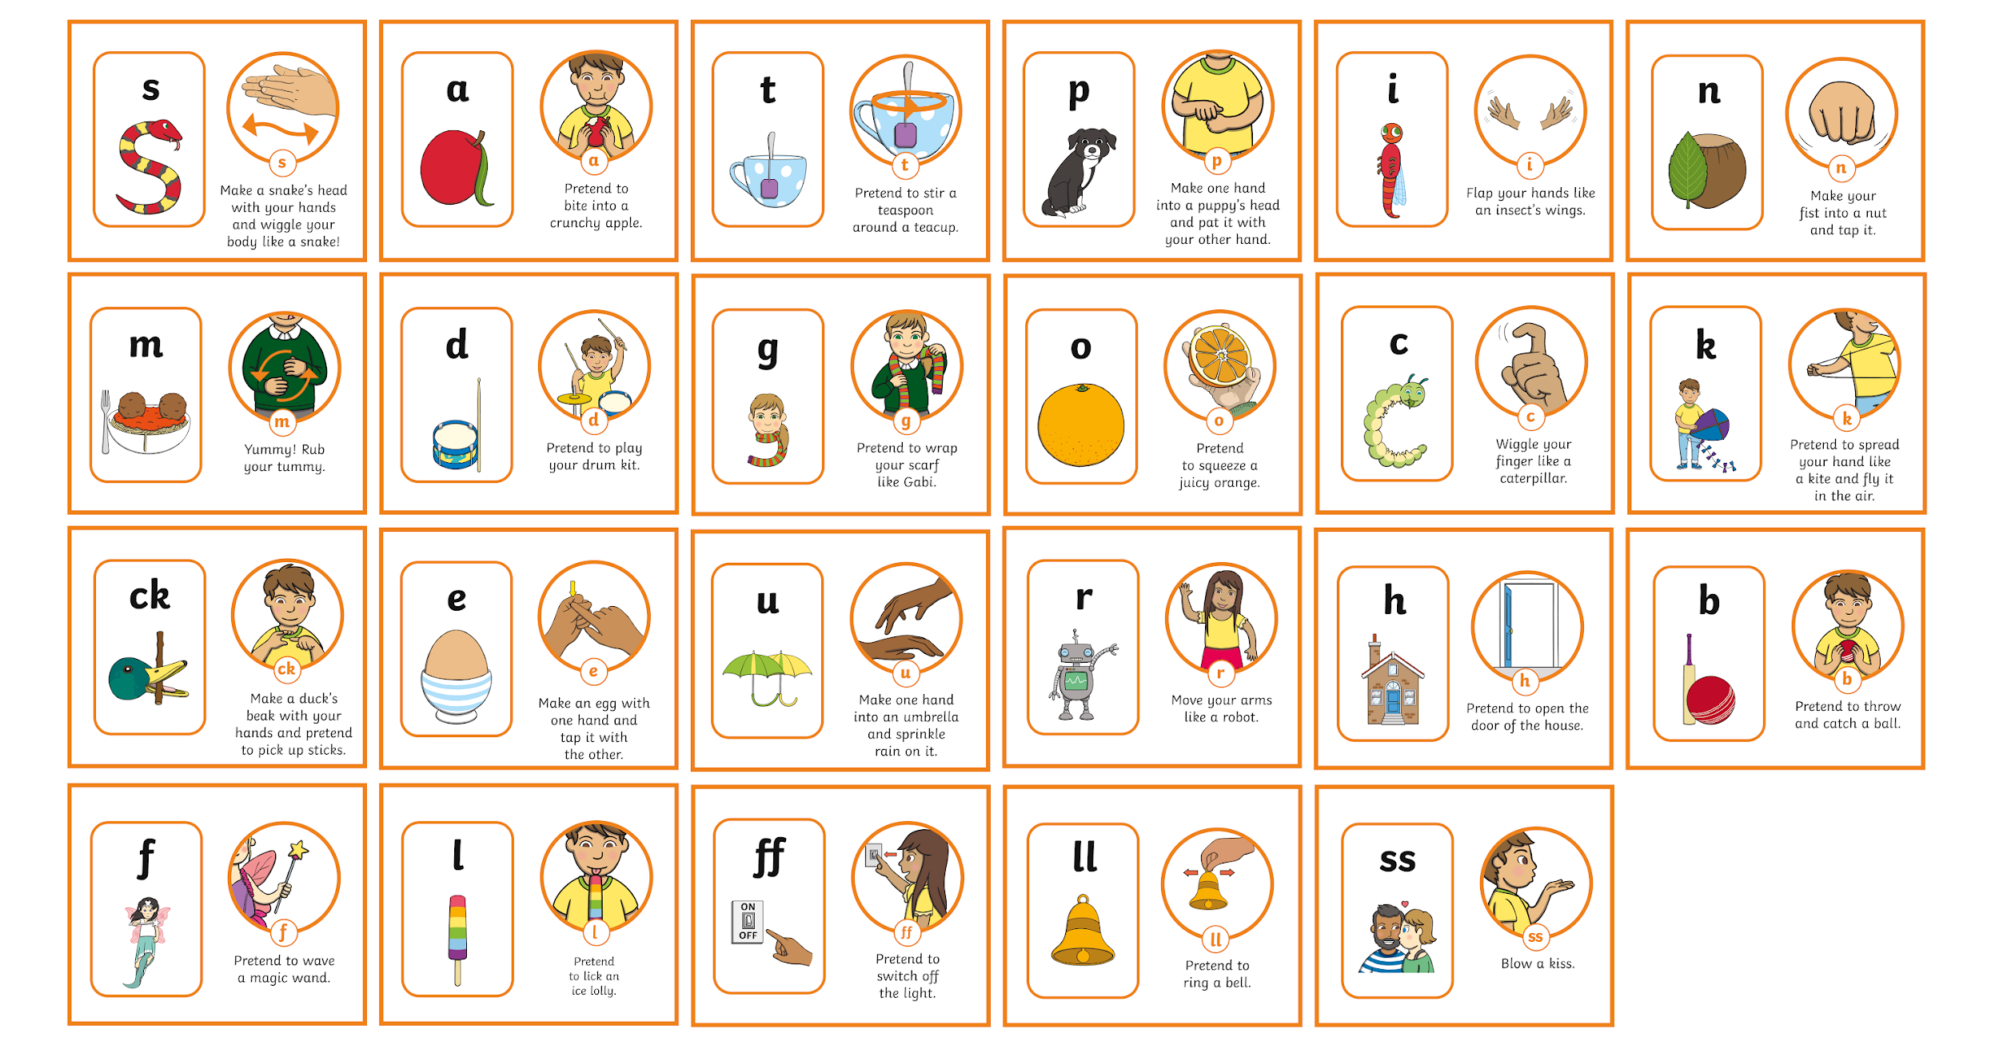
      Level 2 Actions and Mnemonics
Every sound has a corresponding action and mnemonic which helps children to remember them. You can support your child by modelling the same sounds and actions at home.

Slide 11
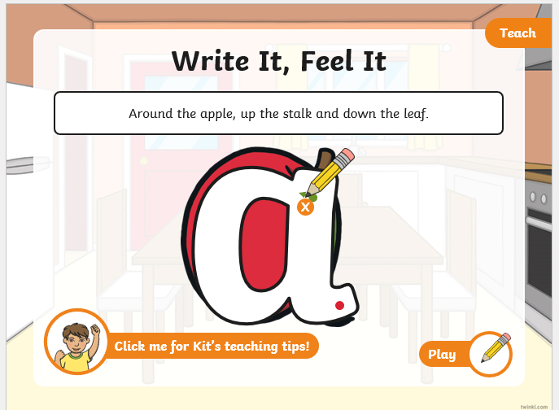
      Level 2 Actions and Mnemonics
Every sound has a corresponding action and mnemonic which helps children to remember them. You can support your child by modelling the same sounds and actions at home.

Slide 12

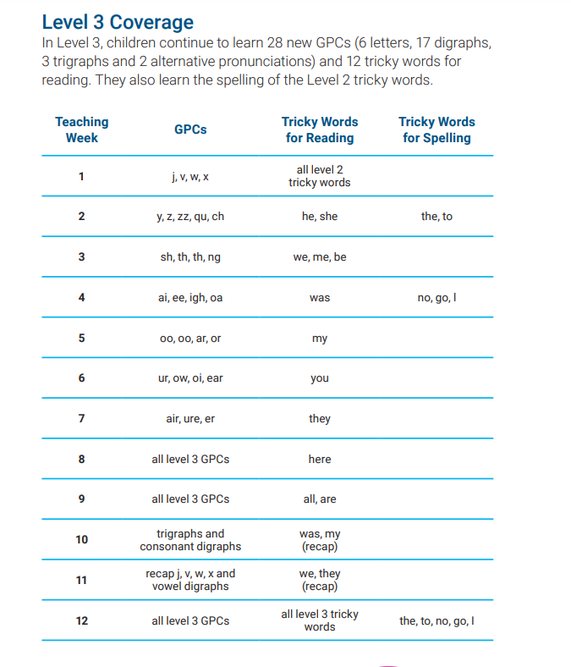

      Level 3
Level 3 is taught in Reception.
By the end of Level 3, children will have had the opportunities to:
say the phoneme when shown all or most Level 2 and Level 3 graphemes;
find all or most Level 2 and Level 3 graphemes, from a display, when given the phoneme;
blend and read CVC words (single-syllable words consisting of Level 2 and Level 3 graphemes) such as ‘chop’ and ‘night’;
segment and make phonetically plausible attempts at spelling CVC words (single-syllable words consisting of Level 2 and Level 3 graphemes) such as ‘paid’ and ‘seed’;
read the tricky words - he, she, we, me, be, was, my, you, her, they, all, are & spell the tricky words - the, to, I, no, go;
write each letter correctly when following a model.

Slide 13
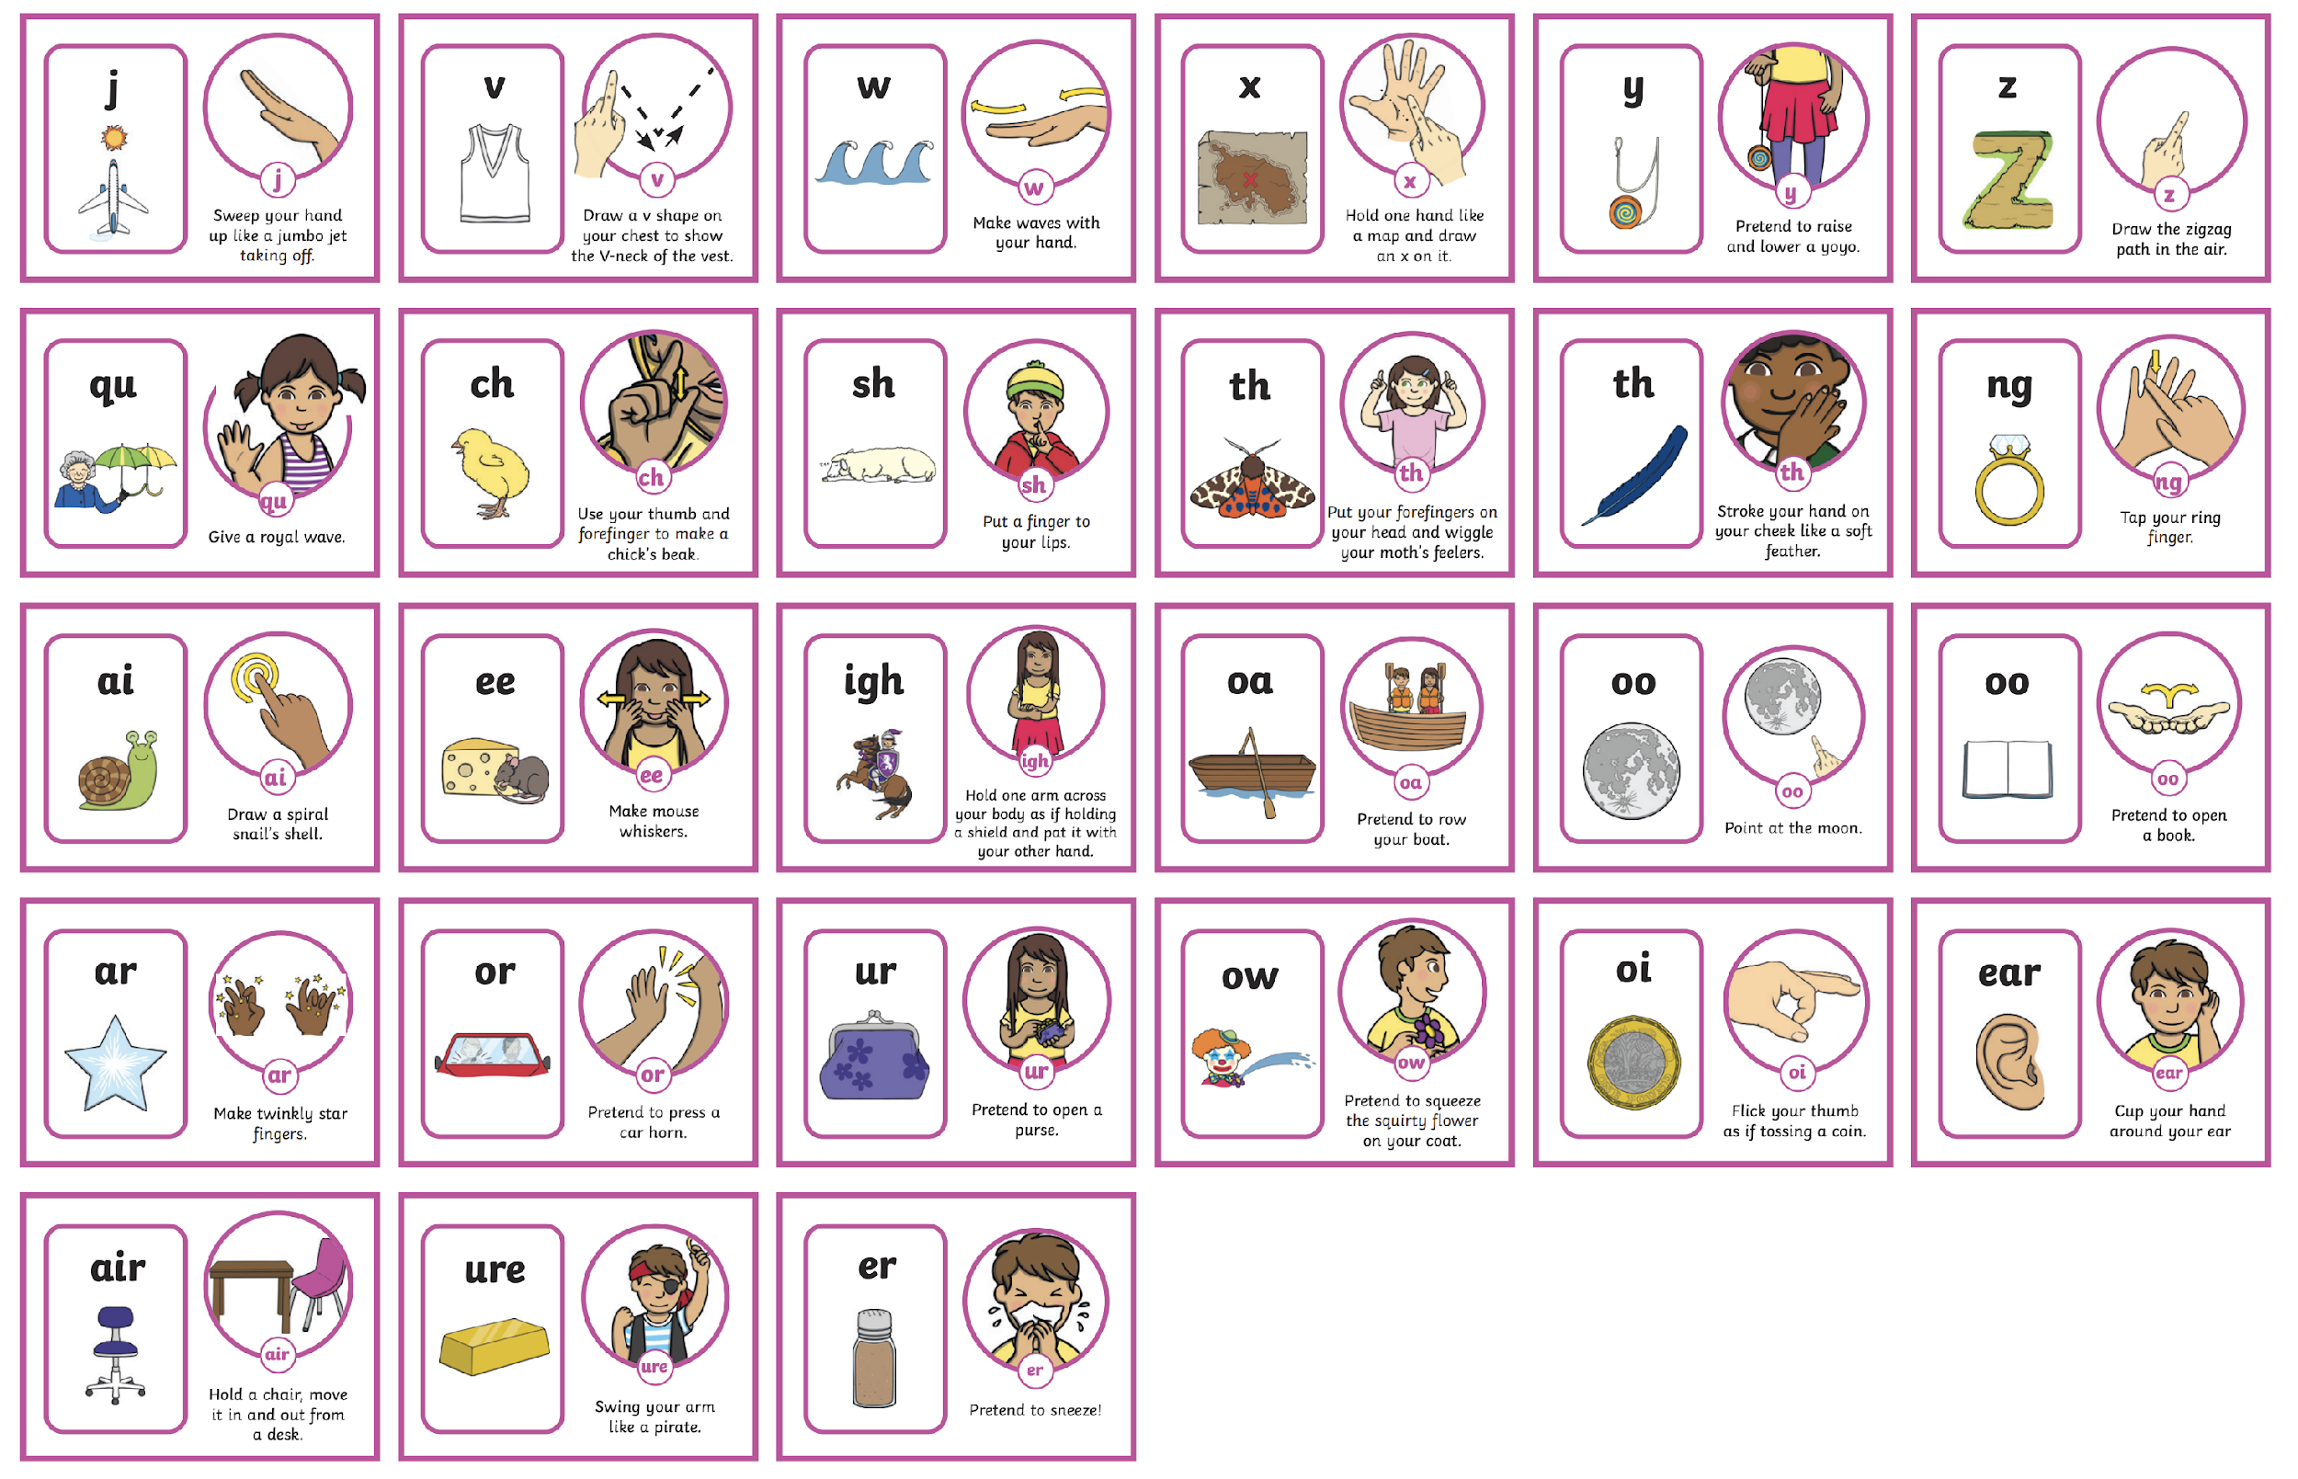
      Level 3 Actions and Mnemonics
It is really important that children learn to form the letters using the correct letter formation when writing. As they are introduced to a new sound, children are taught how to write it correctly. It would be great if you could also model this at home.

Slide 14
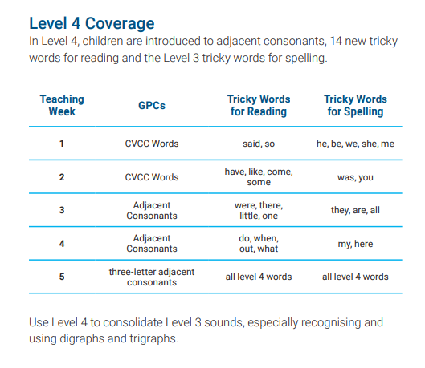

      Level 4
Level 4 is taught in Reception.
By the end of Level 4, children will have had the opportunities to:
give the phoneme when shown any Level 2 or Level 3 grapheme;
find any Level 2 or Level 3 grapheme when given the phoneme;
blend and read words containing adjacent consonants as well as segment and spell words containing adjacent consonants, such as ‘sand’, ‘bench’ and ‘flight’;
read the tricky words - some, one, said, come, do, so, were, when, have, there, out, like, little, what & spell the tricky words - he, she, we, me, be, was, my, you, here, they, all, are;
write each letter, usually using the correct formation;
orally segment words into phonemes.
No new sounds are taught in Level 4.

Slide 15

      Level 5
Level 5 is taught in Year 1.
By the end of Level 5, children will have had the opportunities to:
give the phoneme, when shown any grapheme that has been taught;
for any given phoneme, write the common graphemes;
apply phonics knowledge and skills as the primary approach to reading and spelling unfamiliar words that are not completely decodable;
read and spell phonically decodable two-syllable and three-syllable words such as ‘dolphin’ and ‘parachute’;
read automatically all taught tricky and common exception words;
accurately spell all the Level 2, 3 and 4 tricky words and most of the common exception words for reading;
form each letter correctly;
use alternative ways of pronouncing and representing the long vowel phonemes.

Slide 16
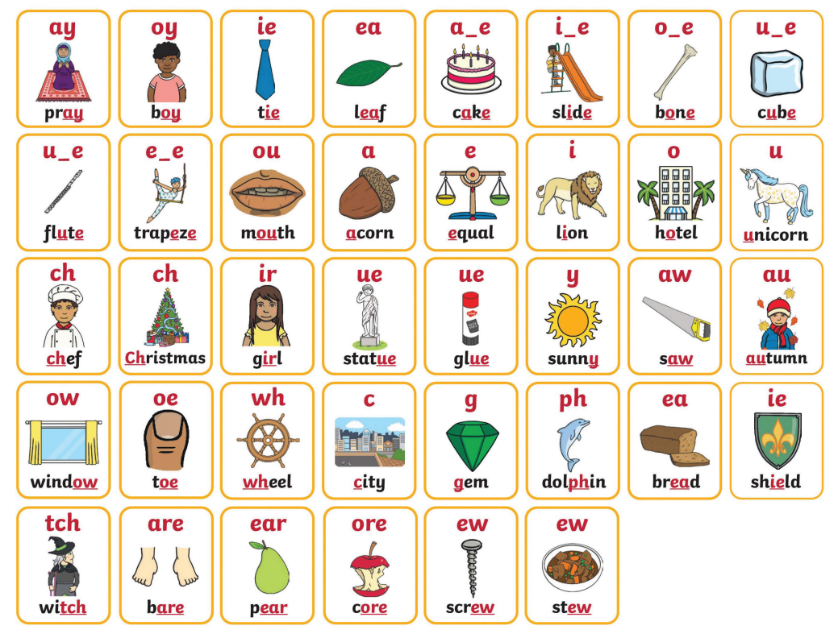
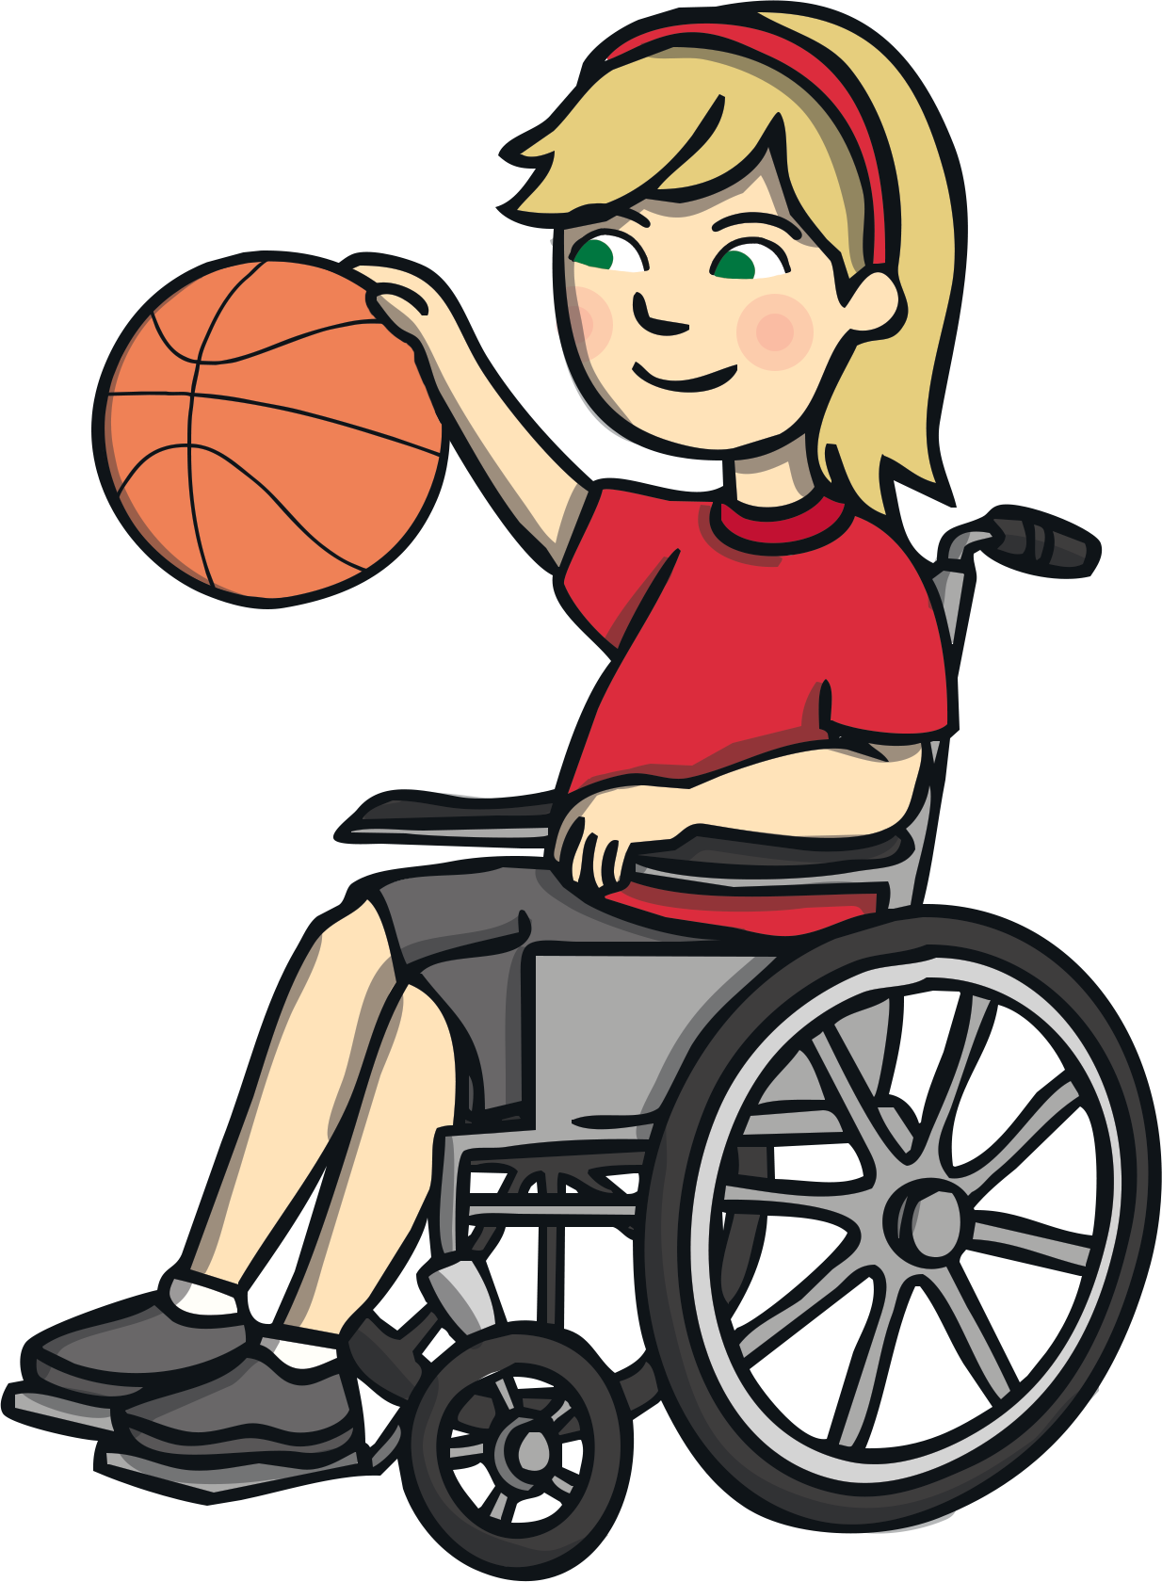
      Level 5 Mnemonics
The new sound is displayed within a word linked to the mnemonic for Level 5.

Slide 17
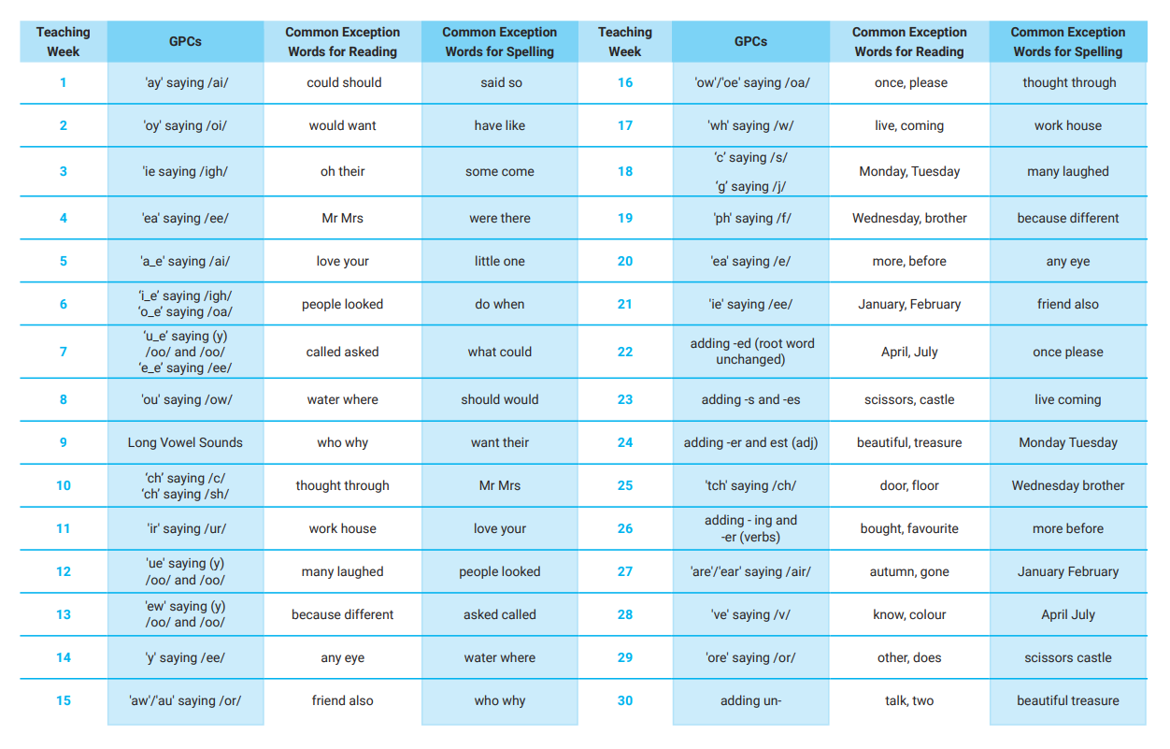
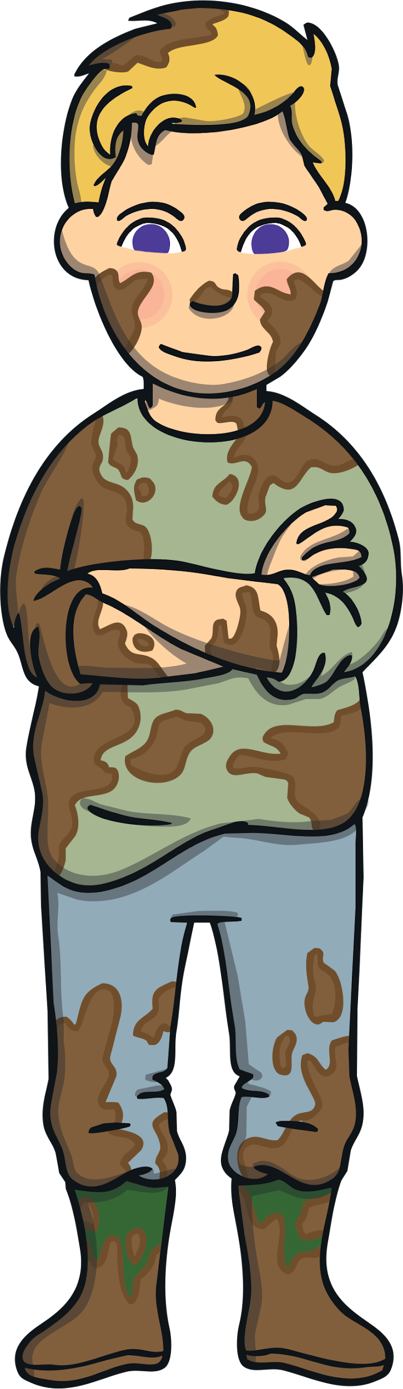
      Level 5 Overview

Slide 18

      Level 6
read accurately most words of two or more syllables;
Level 6 is taught in Year 2.
By the end of Level 6, children will have had the opportunities to:
read most words containing common suffixes;
read most common exception words;
read most words accurately, in age-appropriate books, without overt sounding and blending, fluent enough to allow them to focus on their understanding rather than on decoding individual words;
At this stage, children can read hundreds of words automatically. They are now reading for pleasure and reading to learn rather than learning to read.
sound out most unfamiliar words accurately, without undue hesitation;
segment spoken words into phonemes and represent these by graphemes, spelling many of these words correctly and making phonetically plausible attempts at others;
spell most common exception words correctly.

Slide 19
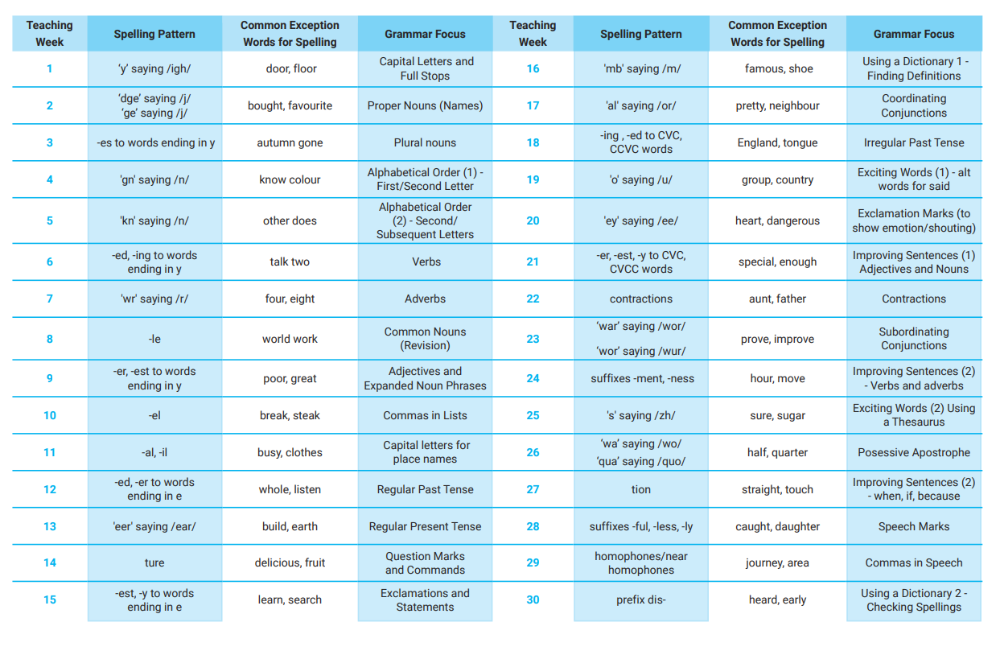
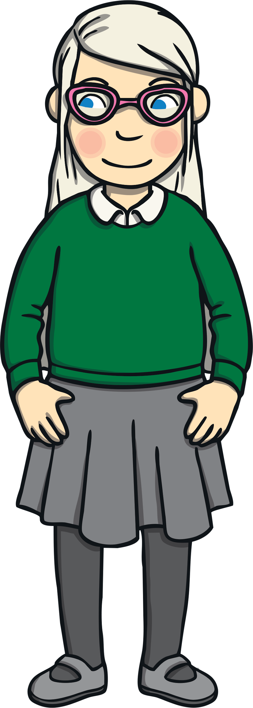
      Level 6 Overview

Slide 20
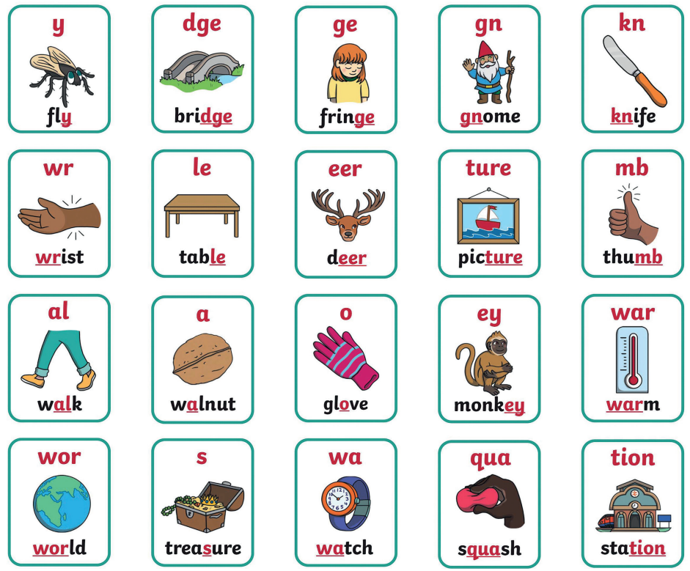

      Level 6 Mnemonics

Slide 21
      What does a lesson look like?
Each lesson starts with a ‘revisit and review’ session. This is a time to go over sounds learnt in previous lessons.
This is followed by the introduction of a new sound. For younger children this is daily, for older children this may be weekly.
There is an opportunity to apply what has been taught through reading games and/or writing activities.
There are also follow-up game, activities at workbooks that may be used in your child’s class.

Slide 22
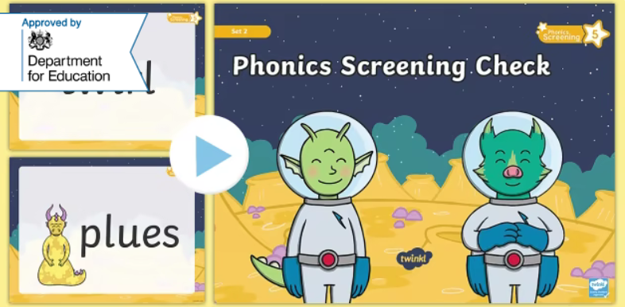
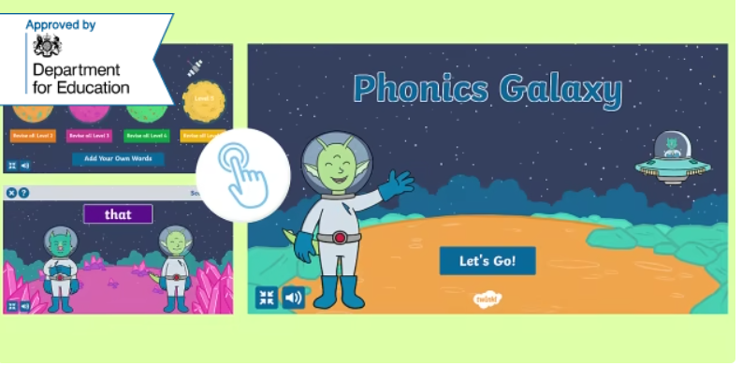
      Year 1 Phonics Screening Check
In June, all year 1 children are expected to complete the Year 1 Phonics Screening Check.
The aim is to check that a child is making progress in phonics. They are expected to read a mixture of real words and ‘nonsense’ words. (Nonsense words can also be referred to as ‘pseudo’ or ‘alien’ words)
For more information why not take a look at the
Twinkl Phonics Year 1 Screening Check Guide for Parents
If a child has not reached the expected standard, schools must give additional support to help the child to make progress in year 2.
Children who have not passed the check in year 1 will have the opportunity to retake it in year 2.

Slide 23


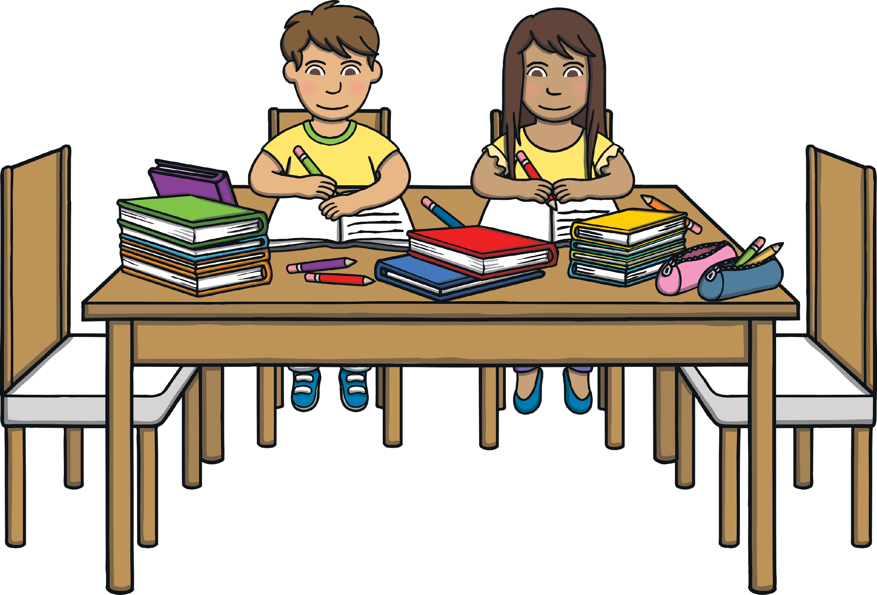
      How You Can Help Your Child at Home
Work on listening skills, taking turns and encouraging your child to look at you when you are speaking.
Practise segmenting and blending words.
Look for familiar sounds and words in the world around you. Such as, when in the supermarket, can your child find words on your shopping list or recognise letters on food packaging?
When outside, can they recognise letters on street names or on car number plates?
When in the house, can they recognise letters or words in magazines or letters you receive?

Slide 24
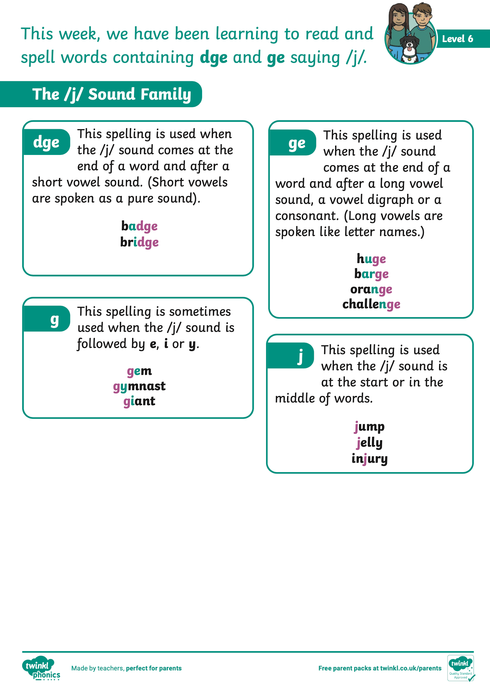
      How You Can Help Your Child at Home
Practise the new sounds and graphemes your child brings home using the Parent Information Sheets. Remember to use ‘pure’ sounds when pronouncing the sounds and model the correct letter formation as is taught in school.
Support your child to work through letter formation sheets and their flashcard packs.
Read to and with your child every day.
Finally, remember to ask your child’s class teacher if you are unsure about any aspect of your child’s phonics learning. A consistent approach is important.

Slide 25
      Any Questions?

Slide 26
