Slide 2
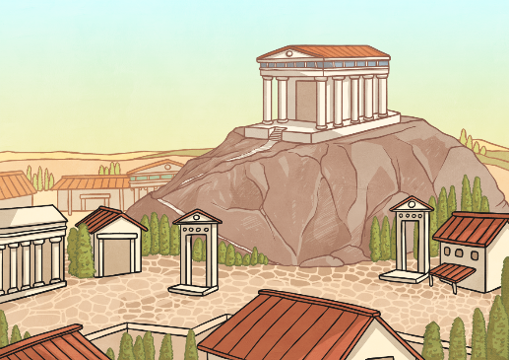
Athens
Sparta
vs
Athens’ Government ruled as a democracy. They were first ever to rule in this way.
The city was built below the acropolis which stood on a high hill above Athens.
Sparta was a city strictly ruled by the king. He made all the decisions in Sparta.
Sparta is surrounded by mountains which made it very difficult for it to be invaded.

Slide 3
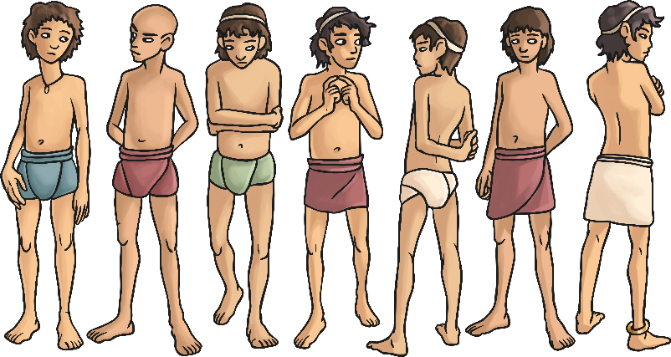
Boys in Athens
Boys in Sparta
vs
vs
Athens was a creative state.
They believed in good education for boys.
Boys could join the army or navy if they wanted to.
Sparta was a city focused on obedience and war. The people did not have any luxuries.
Boys did not have to work or be educated as they trained to be warriors from an early age.
Boys had to join the Spartan army.

Slide 4
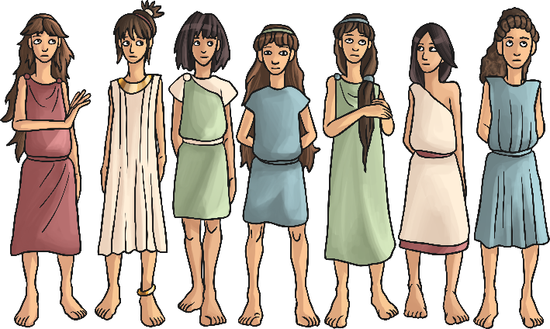
Girls in Athens
Girls in Sparta
vs
vs
Girls were not seen as important in Athens.
Girls could be taught at home only if they had rich parents.
Girls were not allowed to take part in war, business or education.
Girls grew up to be mothers of warriors.
Although they were not allowed to fight, girls took part in the training because fit women produced healthy babies.

Slide 5
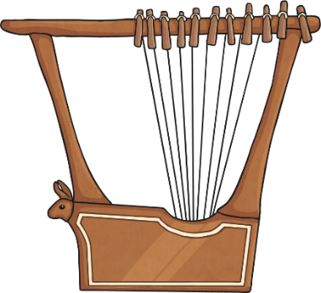
Education in Athens
Education in Sparta
vs
vs
Boys were in education from 6-20 years.
Books were very expensive so boys had to memorise everything.
They learnt how to play the lyre and about the poet Homer.
Boys and girls went to school at 6 years.
The boys were trained to be warriors with brutal training and harsh conditions.
Girls were taught wrestling, gymnastics and combat skills.

