Slide 1
Science
Living Things and Their Habitats
Year One
Science | Year 5 | Living Things and Their Habitats | Metamorphosis | Lesson 5

Slide 3
Aim
I can compare the life cycles of amphibians and insects.
Success Criteria
I can explain metamorphosis and give examples.
I can describe the life cycles of amphibians and insects.
I can describe the similarities and differences between the life cycles of amphibians and insects.

Slide 4
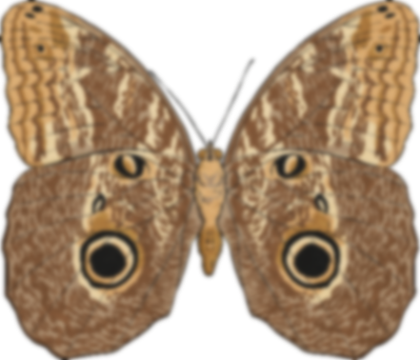
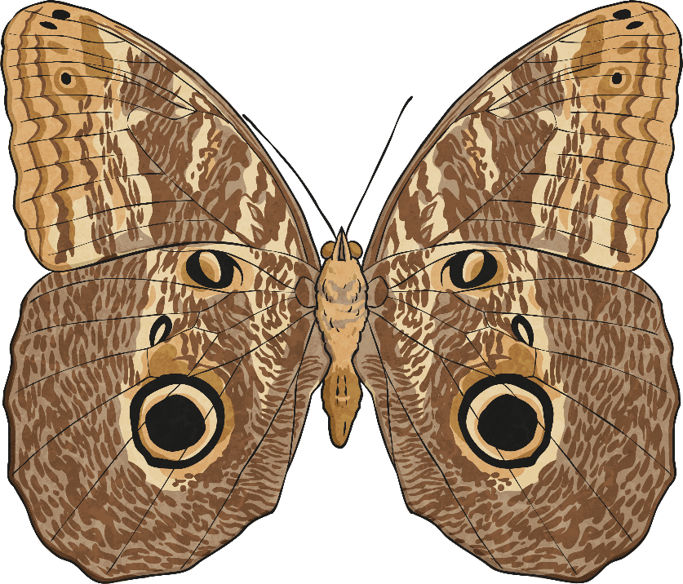
Metamorphosis
Metamorphosis is a process by which animals undergo an abrupt and obvious change in the structure of their body and their behaviour.
Some animals undergo complete metamorphosis, in which they completely transform. Other animals experience incomplete metamorphosis, where they go through several different stages, with each stage getting bigger than the last.

Slide 5
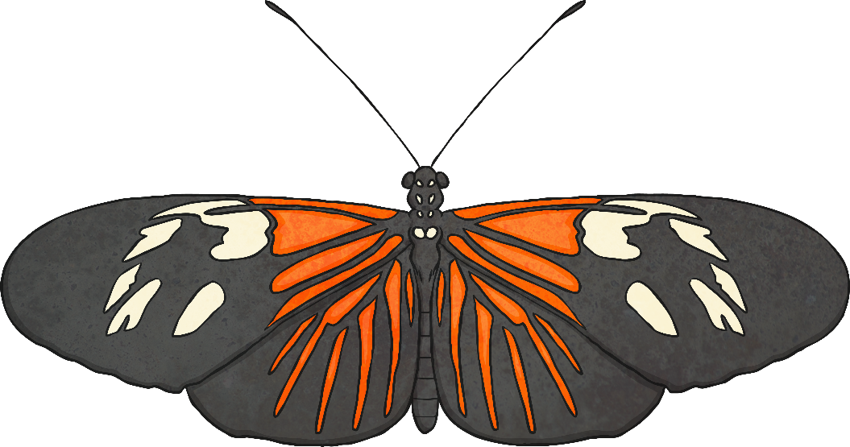
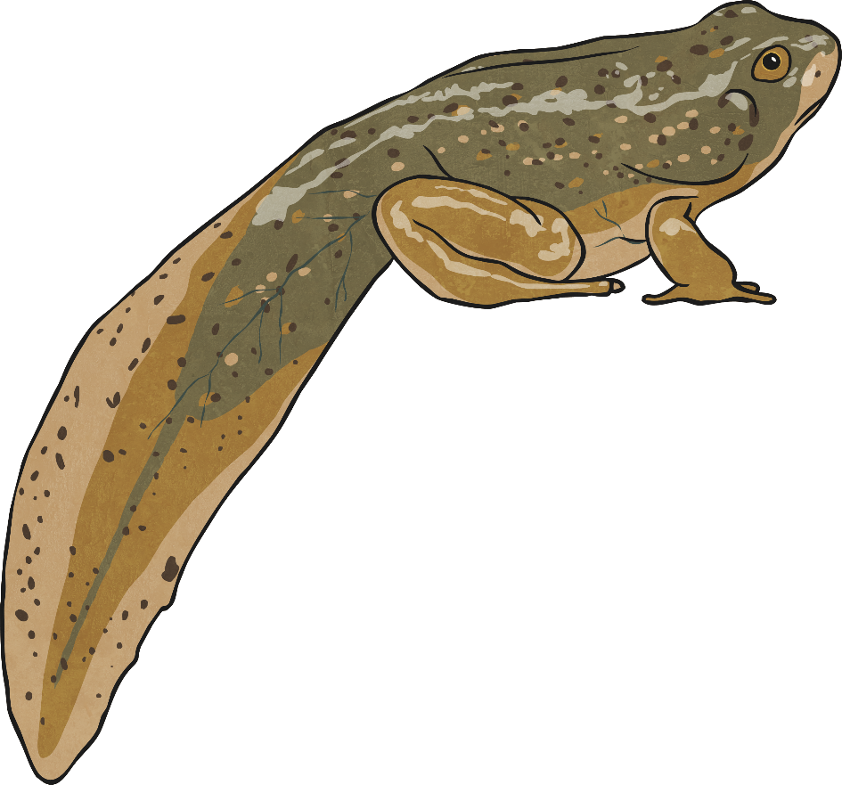
Animals That Change
Talk to your partner about any animals you know that undergo metamorphosis. How do they change and transform? Use these pictures to help you get started!

Slide 6
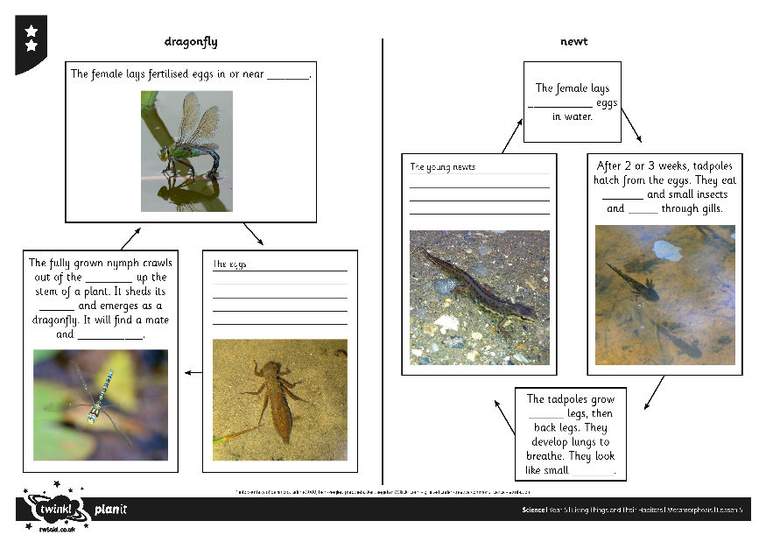
Amphibians and Insects
Amphibians and insects are examples of animals that undergo metamorphosis. Their life cycles show the stages of their transformations.
Can you find the clues around your classroom to complete the life cycles on your Amphibians and Insects Activity Sheet?

Slide 7
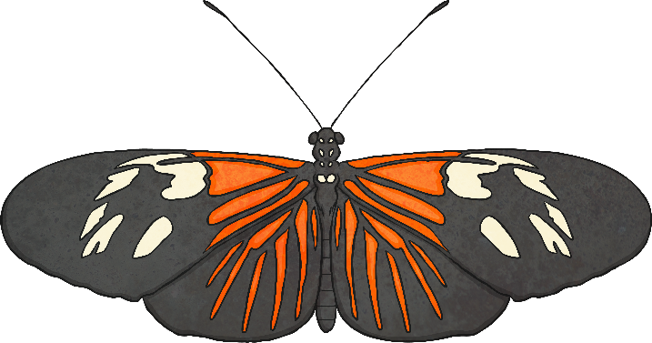
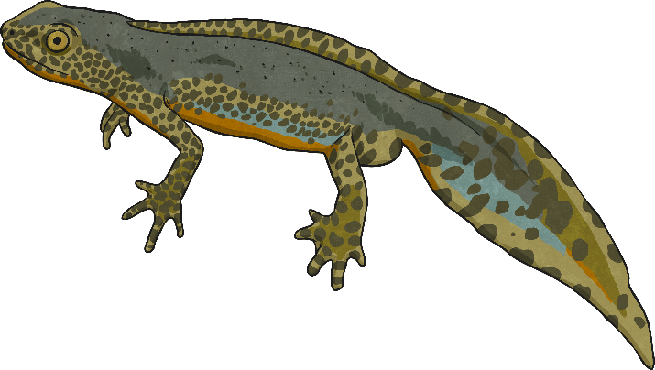
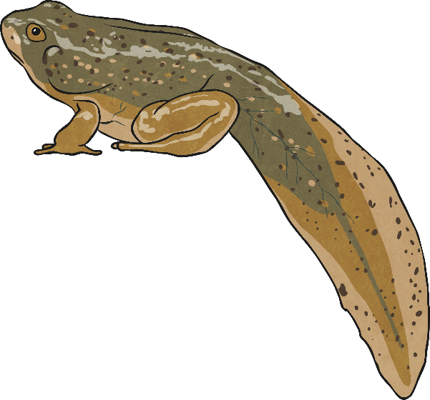
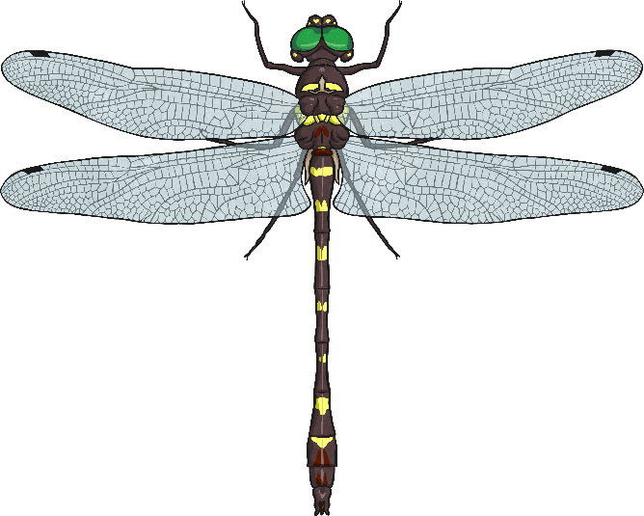
Comparing Life Cycles
Look at the life cycles you have described on your Amphibians and Insects Activity Sheet.
Can you find 3 similarities between the life cycles of the 4 animals?
Now identify 3 differences between the life cycles.

Slide 8
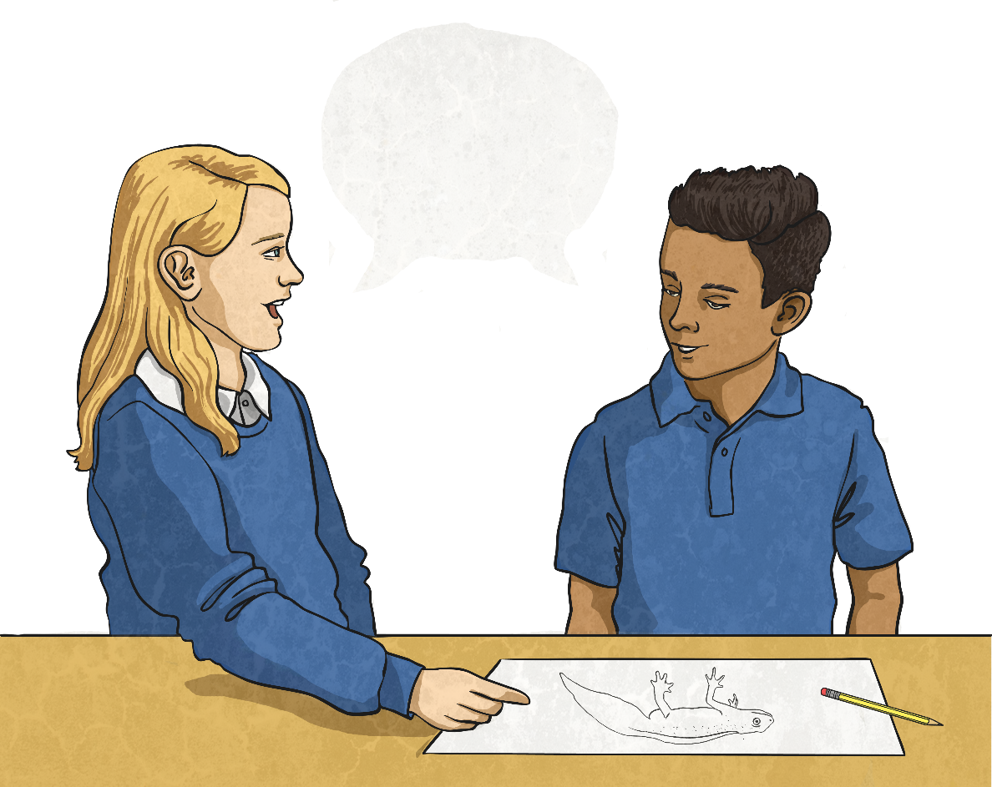
Metamorphosis Draw-off
?
Take turns to draw an animal that undergoes metamorphosis. You can draw it at any stage of its metamorphosis.
Can your partner guess which animal you have drawn? And can they name the other stages in this animal's life cycle?

Slide 9
Aim
I can compare the life cycles of amphibians and insects.
Success Criteria
I can explain metamorphosis and give examples.
I can describe the life cycles of amphibians and insects.
I can describe the similarities and differences between the life cycles of amphibians and insects.

