Slide 1
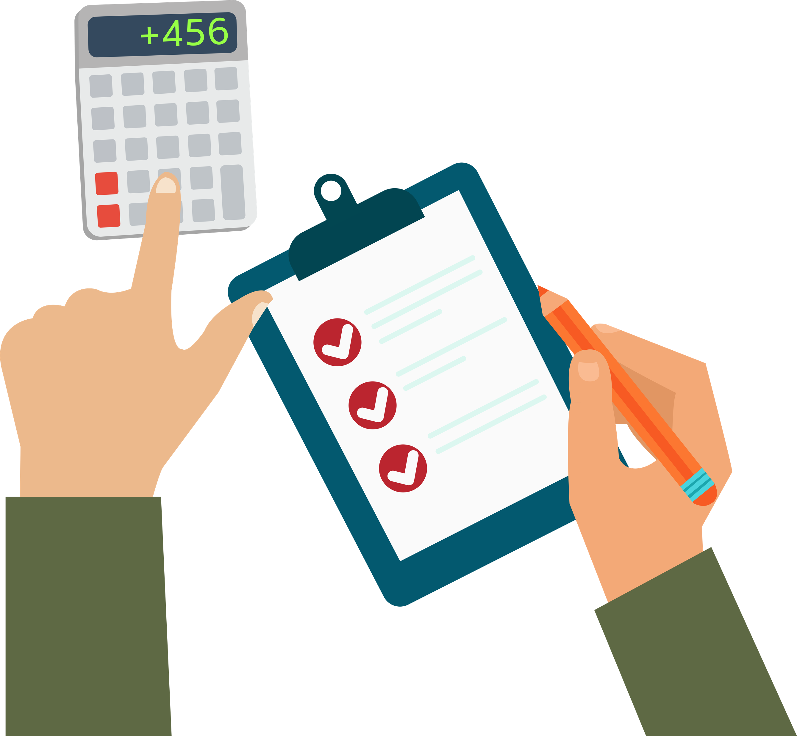
How do I plan a simple budget?
Presentation

Slide 2
Create a mind map to show your understanding of these terms:
Debt
Bank
statement
Saving
Income
Spending
Needs and wants
Payslips
Expenditure
Bills
Receipts

Slide 3
Meet the Williams family
Mrs Williams works as an office manager and travels to work on the train.
Mr Williams has his own business
as an electrician.
Their son, Liam, has football lessons each week and their daughter, Georgia, learns karate. The family have two pets – a cat and a dog.
They enjoy doing fun things together as a family.
BUT… they want to make sure that they’re not spending more money than they earn
each month.
How could they do this?

Slide 4
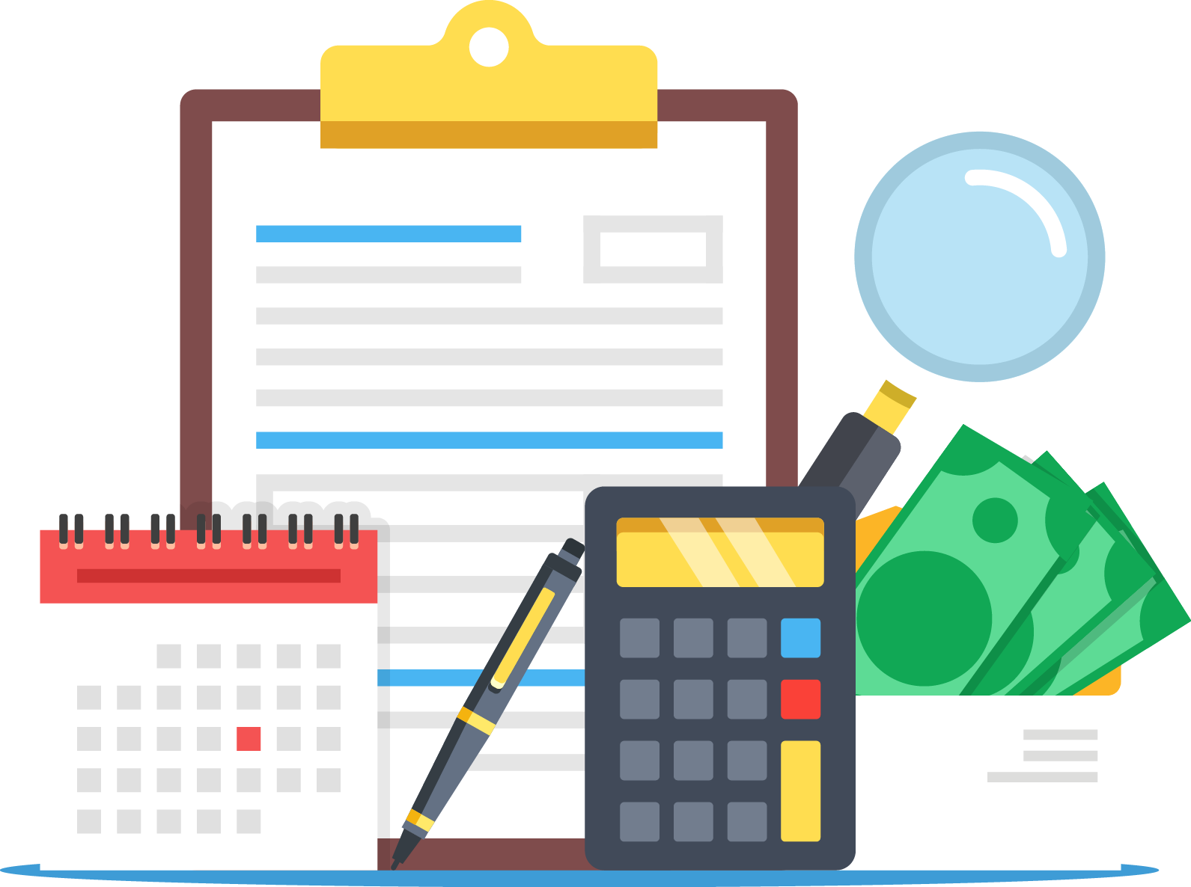
What is a budget?

Slide 5
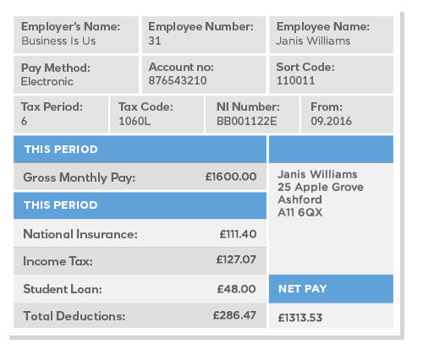
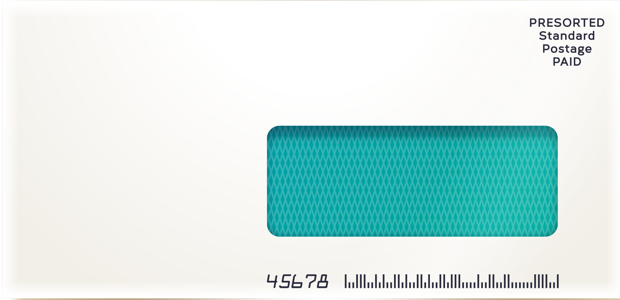
Financial documents – payslip
Many people who are employed in a job get a payslip each month. This shows how much they have earned, as well as what they’ve paid in National Insurance and tax.

Slide 6
Financial documents – bank statement
If you have a bank account, you might get a bank statement each month to show all the money going in and coming out of your account. This could be sent by post or shown online.

Slide 7
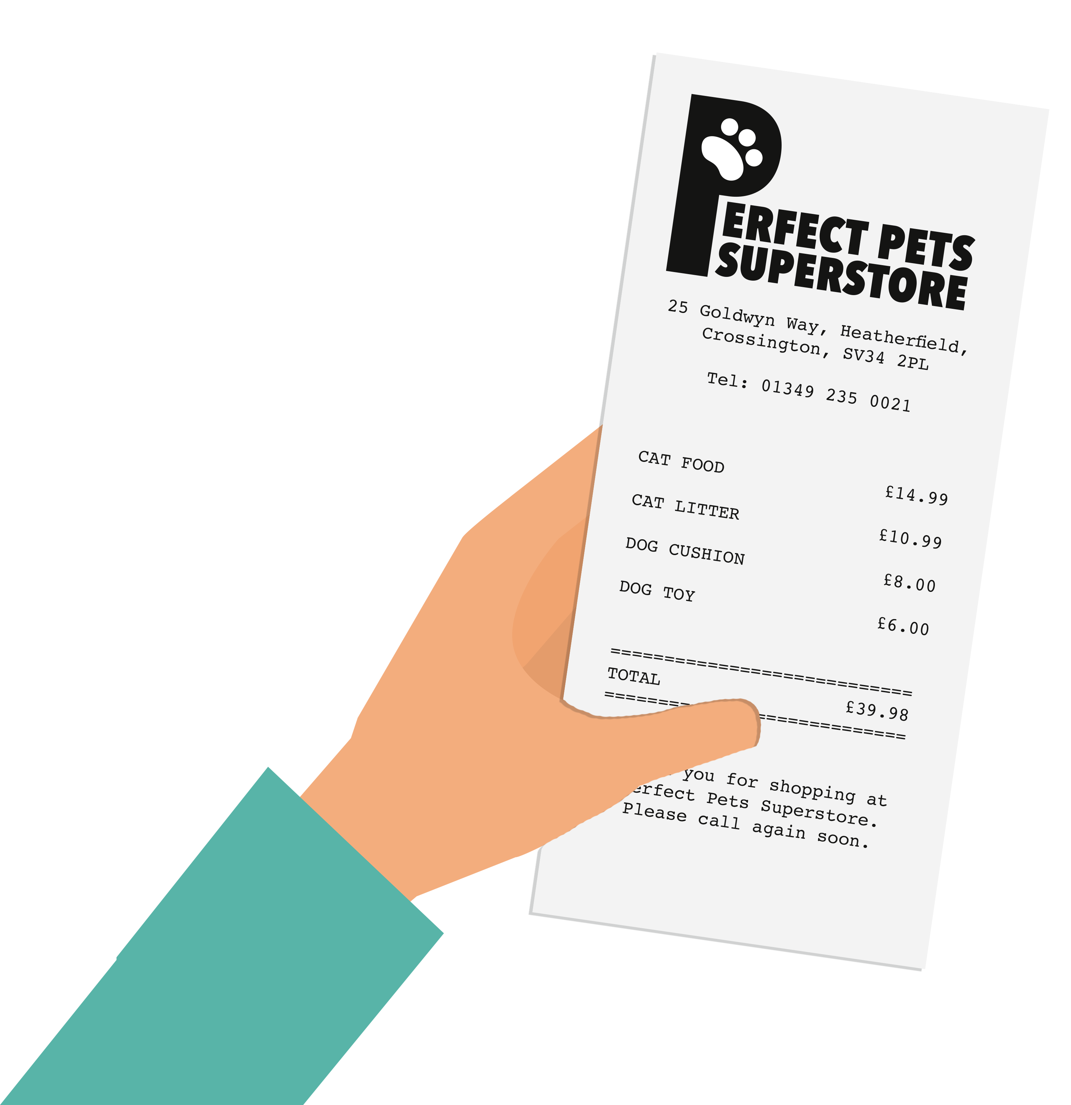
Financial documents – shopping receipt
When you buy something in a shop, you usually get a receipt showing what you’ve bought and how much it cost.

Slide 8
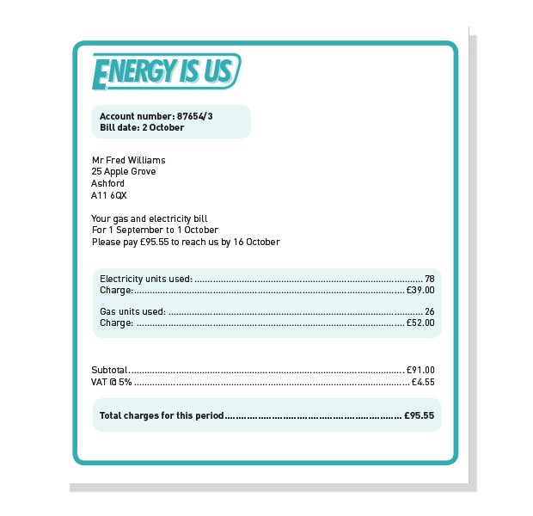
Financial documents – bill
Bills are sent when people owe money to a company. This is a utility bill, which is sent by the energy company supplying gas and electricity to a home. It shows how much money must be paid.

Slide 9
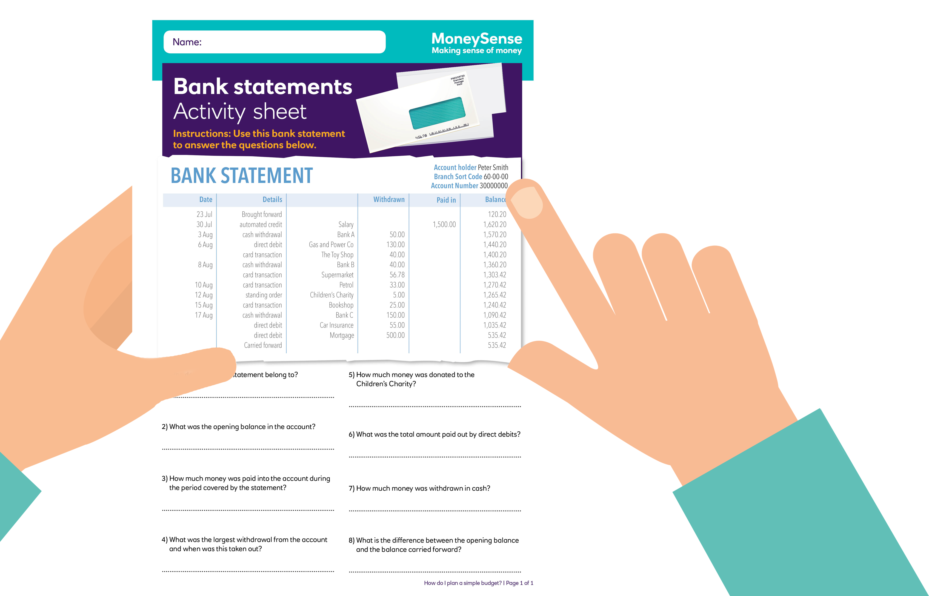
‘Bank statements’ activity sheet

Slide 10
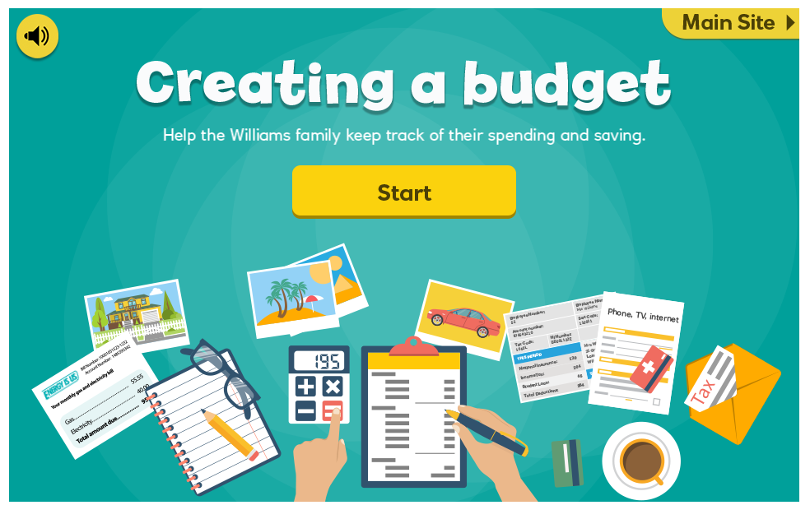
‘Creating a budget’ interactive activity

Slide 11
Why is it important to keep track of spending and saving?
So you can ensure:
You don't go overdrawn and get into debt
You can see what you overspend on and shop around for better deals
You have a record of what you have spent
How do I plan a simple budget? | 11

