Slide 2
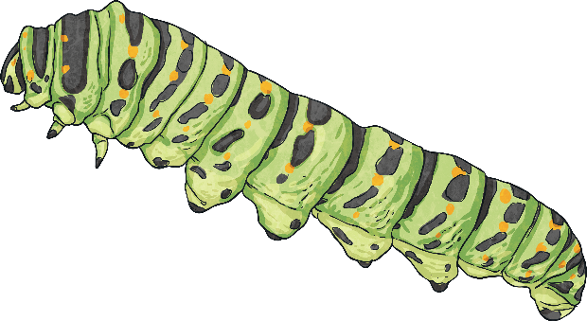
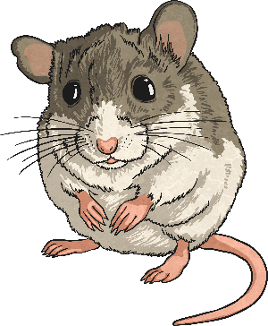
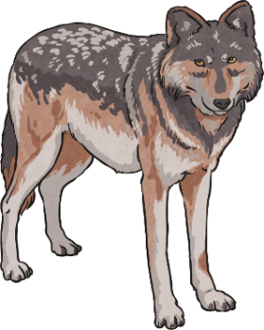
Key Words
consumer
producer
prey
predator

Slide 3
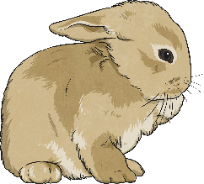
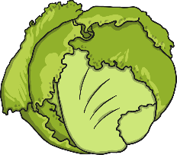
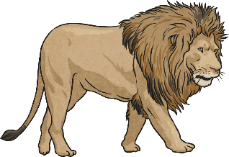
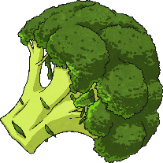
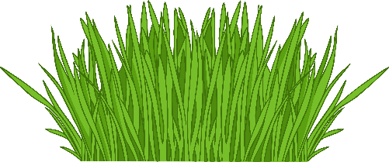
Consumers or Producer?
Producers are plants that make their own food.
Consumers are animals that eat food.
Which are consumers and which are producers?
rabbit
lettuce
lion
broccoli
grass
mouse

Slide 4
Design Your Own Food Chain
All food chains start with a producer.
Arrows are used in a food chain to show who is eaten by who.
eaten by
energy flow
Check
Are the arrows going in the right direction?
Does it have a producer?

Slide 5
Questions
Read the questions below, then use the answer buttons to reveal the answer.
1. What do all food chains start with?
Answer
2. Name a predator and its prey?
Answer
3. Are penguins the prey of polar bears?
Answer
4. Give an example of a consumer that makes honey.
Answer

Slide 6
Questions
5. Write down a food chain including a fox.
Answer
6. Name a producer eaten by a rabbit?
Answer
7. What do the arrows in a food chain show?
Answer
8. Can you name a consumer?
Answer
9. Can you name a producer?
Answer

Slide 7
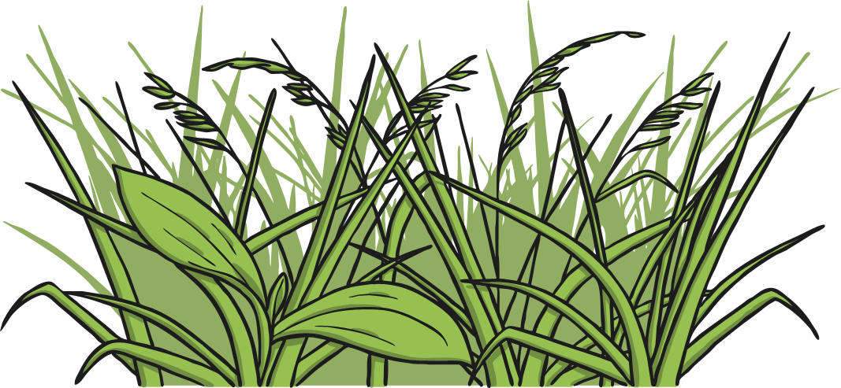
A Producer
Go back to questions

Slide 8
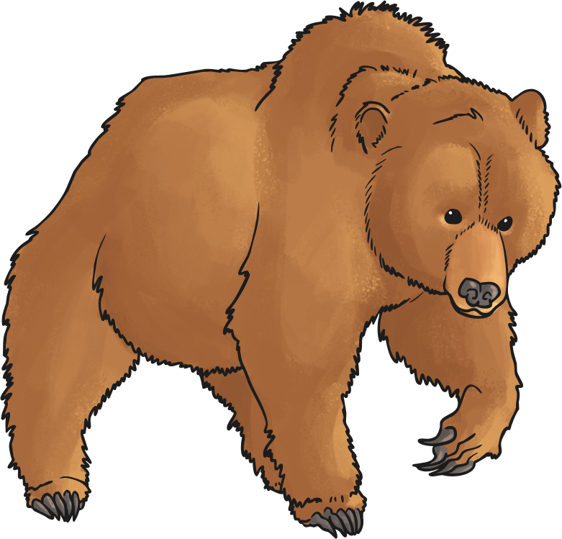
Bear and Fish
How many other examples can you name ?
Go back to questions

Slide 9
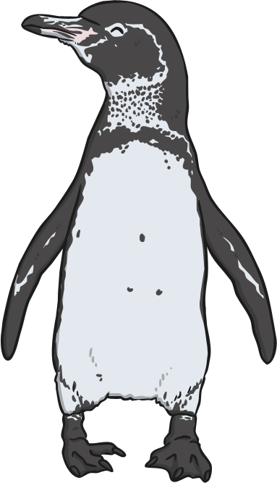
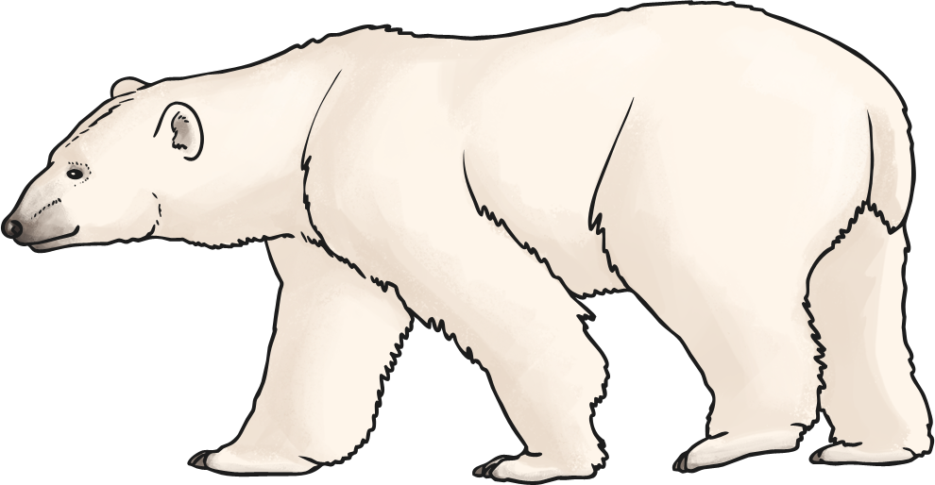
No
Penguins live in the Antarctic and polar bears live in the Arctic.
Go back to questions

Slide 10
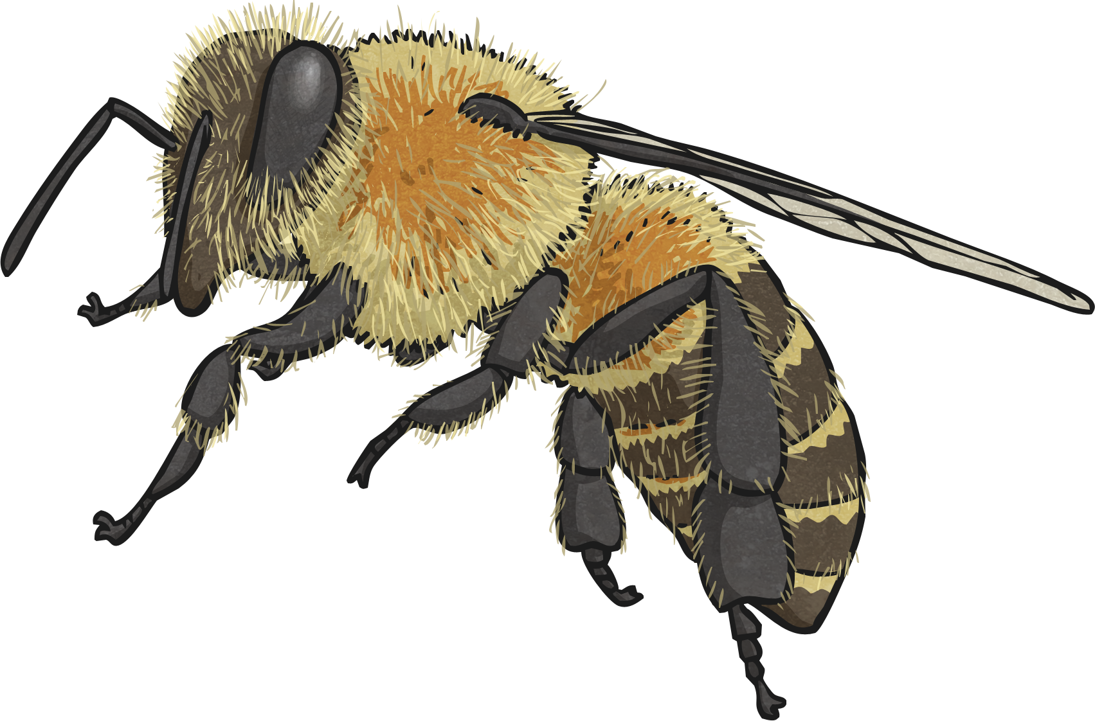
A Bee
Go back to questions

Slide 11
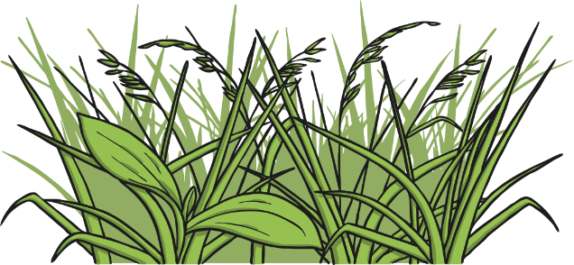
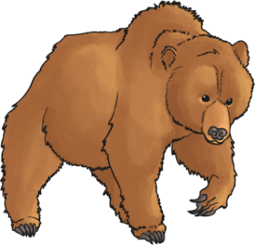
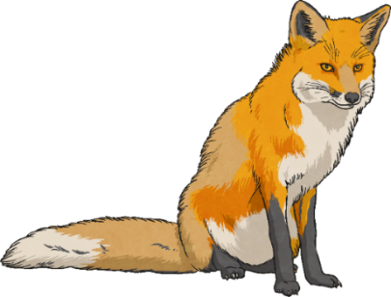
Food chain Including Fox
grass
rabbit
bear
fox
Go back to questions

Slide 12
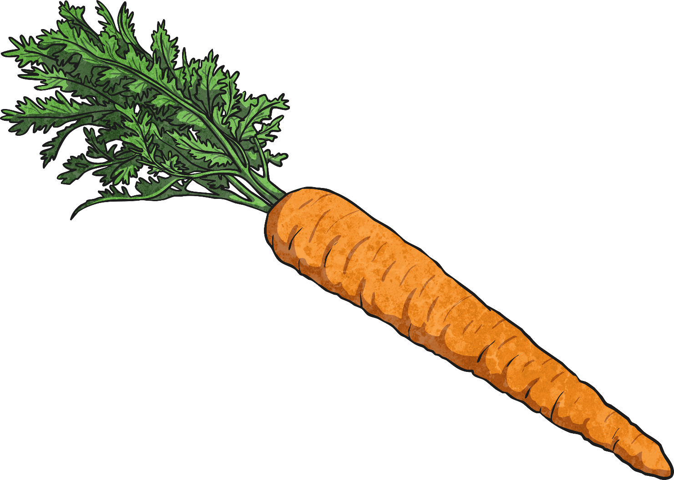
Cabbage, Carrot, Grass
Go back to questions

Slide 13
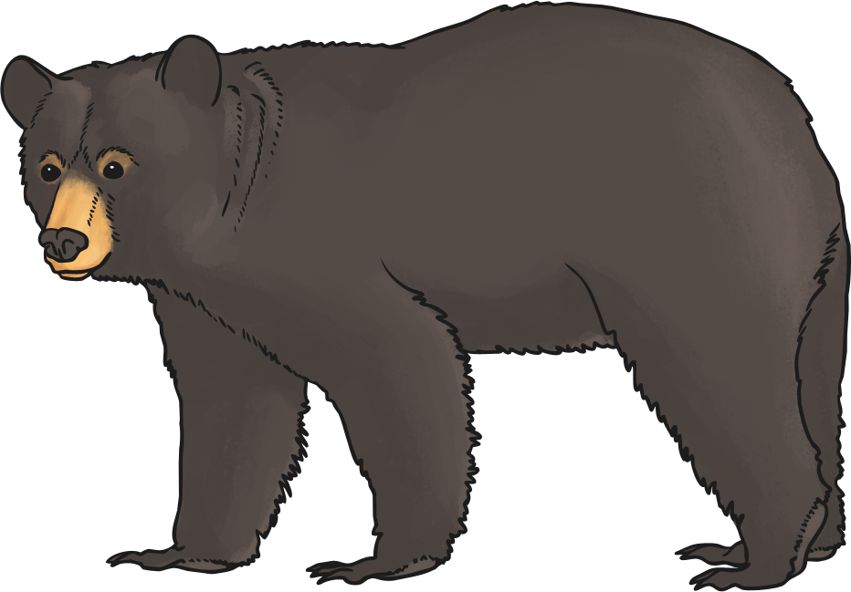
Energy Flow or Eaten By
Go back to questions

Slide 14
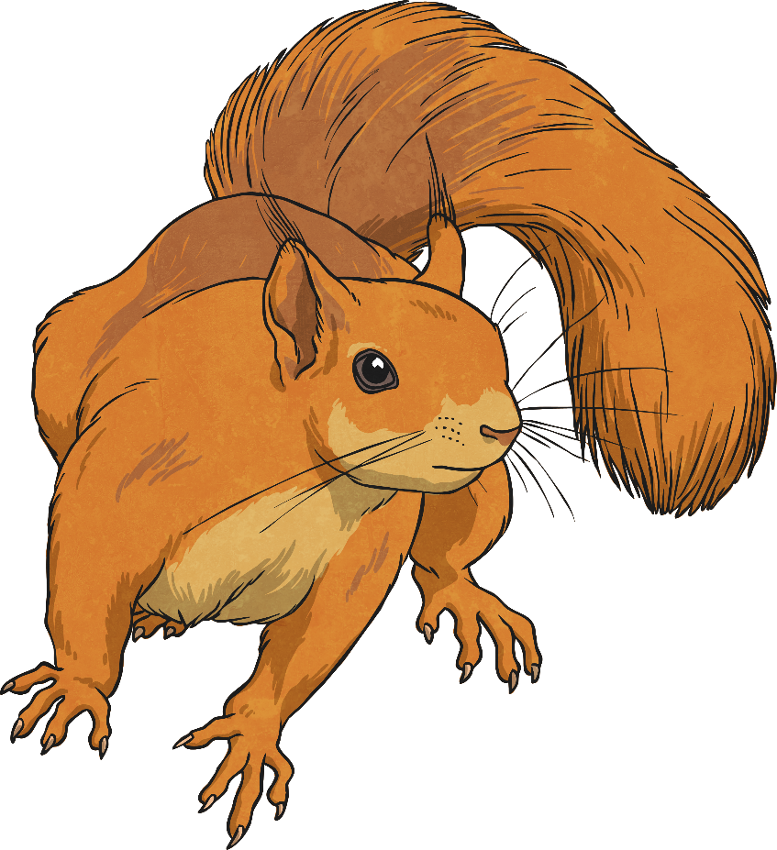
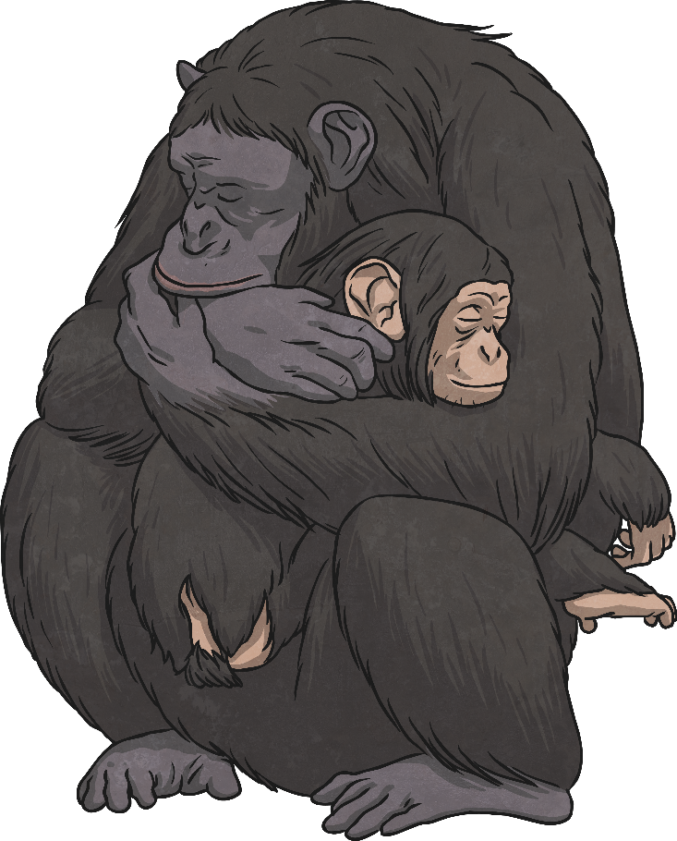
Any Animal
Go back to questions

Slide 15
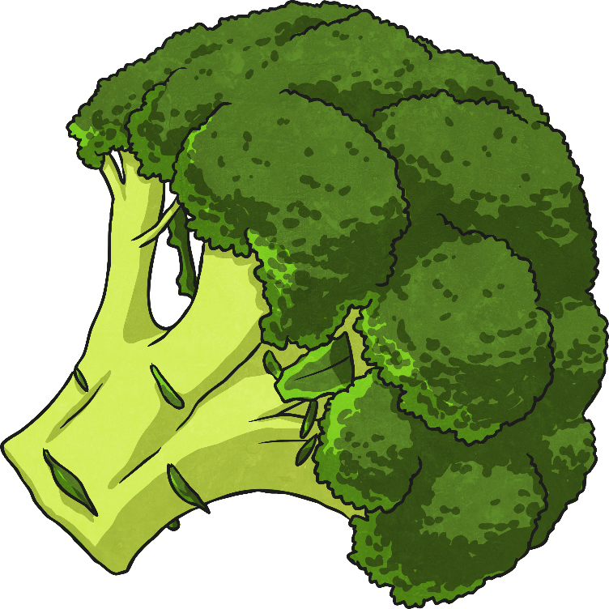
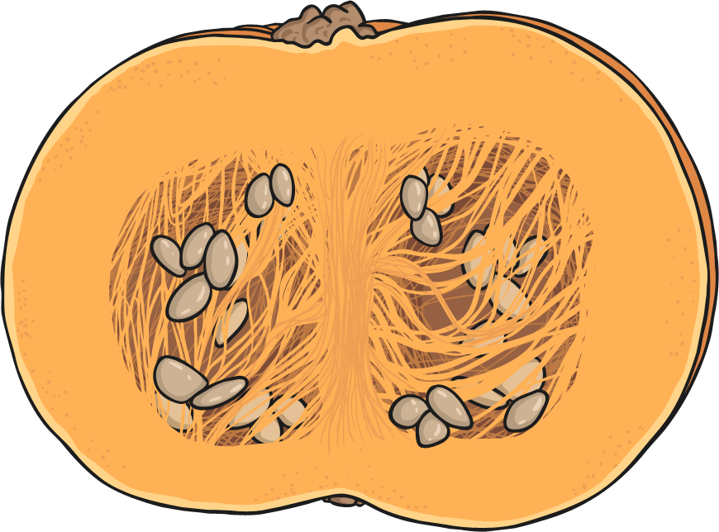
Any Plant
Go back to questions

