Slide 1
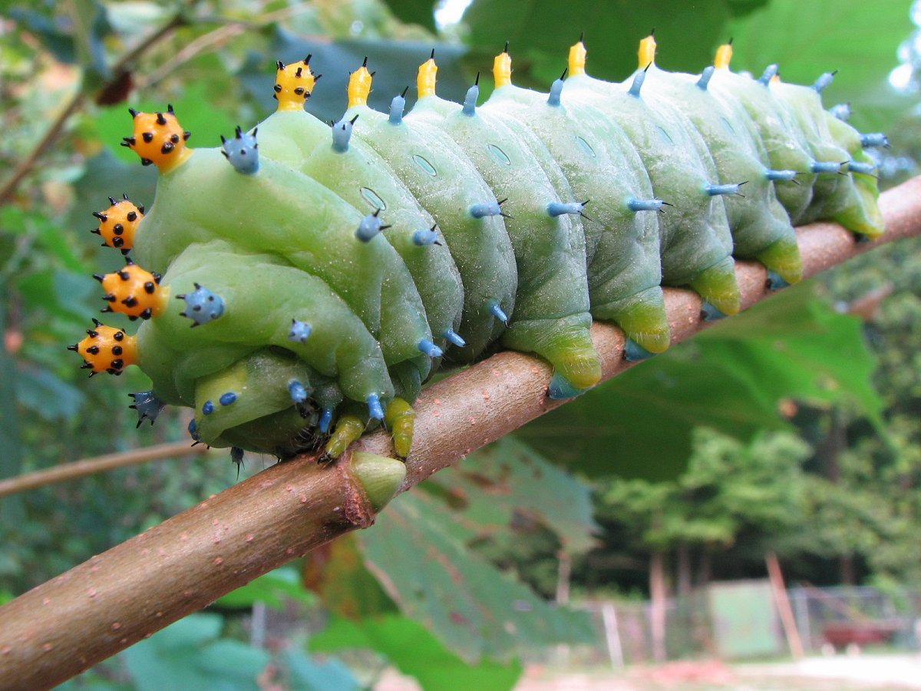
Caterpillar Shoes

Slide 2
Caterpillar Shoes There was a caterpillar. He had a lot of feet. All he did was eat and walk, and eat and walk, and eat. On every pair of feet, a pair of tiny shoes he wore. They stopped his little feet from getting really, really sore. Then, one day, he didn’t want to eat, or walk, at all, And, suddenly, his shoes felt rather tight, and rather small. He had a quite surprising urge to find them all new feet, So he set off through the woods at once, wondering who he’d meet. He found a friendly woodlouse, underneath some logs. Caterpillar asked, “Perhaps you’d like my wooden clogs?” Woodlouse said, “I love them!” and, “I think I’ll do a jig!” Caterpillar said farewell, then set off, up a twig.
Caterpillar ate and walked
Woodlouse - wooden clogs

Slide 3
He walked beneath a spider, dangling from above. Caterpillar called, “I bet my slippers you would LOVE!” Spider said, “I would! They’ll keep my feet as warm as toast!” Caterpillar thought they were the ones he’d miss the most. He was startled by an earthworm, as it woke up from a snooze. Caterpillar said, “That worm does not need any shoes!” He wandered past a grasshopper, doing little jumps. Caterpillar yelled, “I’ve got some bouncy new sports pumps!” Grasshopper said, “Cool, dude! These will help me get some air!” Caterpillar watched him jumping here, there - everywhere!
Spider – slippers
Earthworm – did not need any shoes!
Grasshopper - bouncy, new sports pumps

Slide 4
He bumbled by a beetle with a black and polished shell. Caterpillar said, “My party shoes would suit you well.” Beetle answered, “Thanks! They’re hard and shiny, just like me!” Caterpillar buffed them up, and said, “I quite agree!”
He crawled right past a stick insect - but didn’t even see, Because it was so camouflaged, it looked just like a tree.
Beetle - party shoes
Caterpillar crawled past camouflaged stick insects.

Slide 5
He spied a tiny snail, and its sliming foot was bare. Caterpillar said, “I’d love it if you took a pair!” But snails have just one foot (although they’d really quite like two); Snail said, “Wow! I’m going to RUN!” - but he only took one shoe. And so, just one last shoe remained - just one, all on its own. Caterpillar took it off. It sat there, all alone. He felt quite sad - he didn’t want to waste the shoe, you see - Then there, upon the leaf, he spied a tiny, lonely flea. Caterpillar asked him, “Would you like a place to live? I have one shoe left over, and I’ve got this urge to give.” Flea jumped in and looked around. “This shoe’s so BIG! Hooray!” There’s tons of room for me, and all my friends can come and stay!”
Snail – one trainer
One last shoe – Caterpillar felt sad.
Flea

Slide 6
At last the shoes had found new feet - and one had made a home. Caterpillar said, “I think it’s time to stop my roam.” So, straight away, he climbed a stalk, then dangled from a leaf. He wove himself a silk cocoon, and sighed with great relief. A few weeks later, out he popped. He said at once, “Oh MY!” For while he’d slept he’d turned into a great big BUTTERFLY! He knew that, from this moment, he’d like doing different things - Instead of walking everywhere, he’d fly about, with wings! And as he fluttered up and up, into the sky of blue, He looked down at the woods, and saw some old friends passing through. Butterfly was full of joy, because he knew the shoes, Were making more feet happy - and it didn’t matter whose!
Silk cocoon
Butterfly
Shoes were making more feet happy, and it didn’t matter whose!

Slide 7
How many different types of shoe can you think of?
Make a list!
Re-write the poem as a story for young children to enjoy.
Try to use the inverted commas to show dialogue between the Caterpillar and the other creatures?
Draw and colour the Caterpillar with his many different shoes. Label the shoes with the new owner.
Write your own story but change the animals that Caterpillar meets. What shoes does he give them and why?
What type of shoe does Caterpillar give away to each creature in the poem?
Ideas
Write some word problems involving halving and doubling and pairs of shoes.
Design a pair of , ‘must have’, footwear.
When would you wear them? What would you be doing?
Do they have any special features?
Your design could be possible or something for the future!
Produce an advert for a local magazine to persuade people to buy your ‘must have’, footwear.
Draw and label the life cycle of the butterfly. What other mini-beasts change their bodies when they become adults?

