Slide 2
Aim
To recognise levers, gears and pulleys.
To build a lever, gear and pulley.

Slide 3
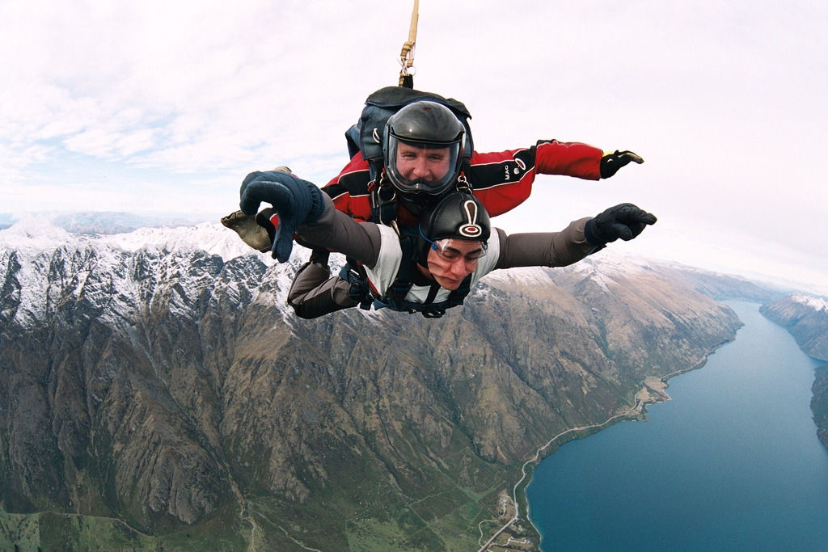
Recap
These sky divers have jumped out of an aeroplane and are falling quickly towards earth.
What forces are affecting them?
Gravity
Air Resistance
Photo courtesy of mnapoleon (@flickr.com) - granted under creative commons licence - attribution

Slide 4
This submarine is diving downwards and forwards into the sea. What forces are affecting it?
gravity
Driving forces of the engines
water resistance
upthrust of the water

Slide 5
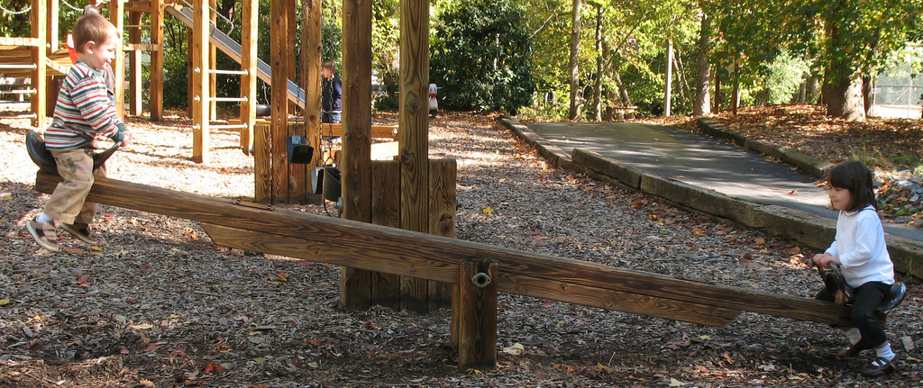
Introduction
Levers, gears and pulleys are all mechanisms that make jobs easier to do.
Or sometimes just for fun!
Photo courtesy of hoyasmeg (@flickr.com) - granted under creative commons licence - attribution

Slide 6
Levers
Levers are the simplest type of mechanism. They are really good at lifting objects and can be used to make objects easier to lift.
Here are three levers. Which lever will make lifting the block easiest?
Let’s find out …
A
B
C
Answer

Slide 7
Gears
Gears are toothed wheels that lock together and turn one another.
The wheels are usually different sizes so that one gear speeds up to slow down the next gear. Gears are also used to change the direction of movement.
How will turning a small gear wheel affect the speed of a larger gear wheel?
Let’s find out…
Answer
If the first gear wheel is smaller (and has fewer teeth) than the second one, then the second (bigger) gear doesn’t have to move as quickly to keep up with the smaller gear. So the second gear wheel turns more slowly than the first.
Photo courtesy of davidjmarland (@flickr.com) - granted under creative commons licence - attribution

Slide 8
Pulleys
Pulleys are like gears but the two wheels do not lock together.
Instead the wheels are joined by a belt. Pulleys can be used to change the speed, direction or force of a movement.
Photo courtesy of sean_hickin (@flickr.com) - granted under creative commons licence - attribution

Slide 9
Lever, Gear or Pulley?
On the tables are a selection of objects that use levels, gears and pulleys to work.
Can you work out which mechanism each object uses? Label the object on your sheet with the name of the mechanism.

Slide 10
Activity
Can you make a pulley to carry an object between 2 tables?
Can you make an object that uses 1 gear wheel to spin 5 other gear wheels even faster?
Can you make a lever to pick something up without using your hands?

Slide 11
Plenary
Which mechanism would be most suited to these jobs?
A
Hoisting a flag up a flagpole

Slide 12
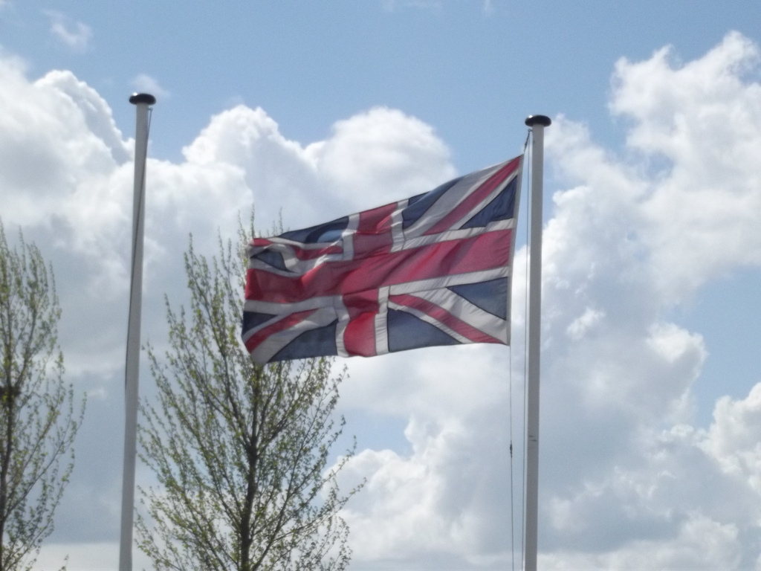
A pulley.
Photo courtesy of ell brown (@flickr.com) - granted under creative commons licence - attribution

Slide 13
Plenary
Which mechanism would be most suited to these jobs?
B
Making one wheel turn faster than another.

Slide 14
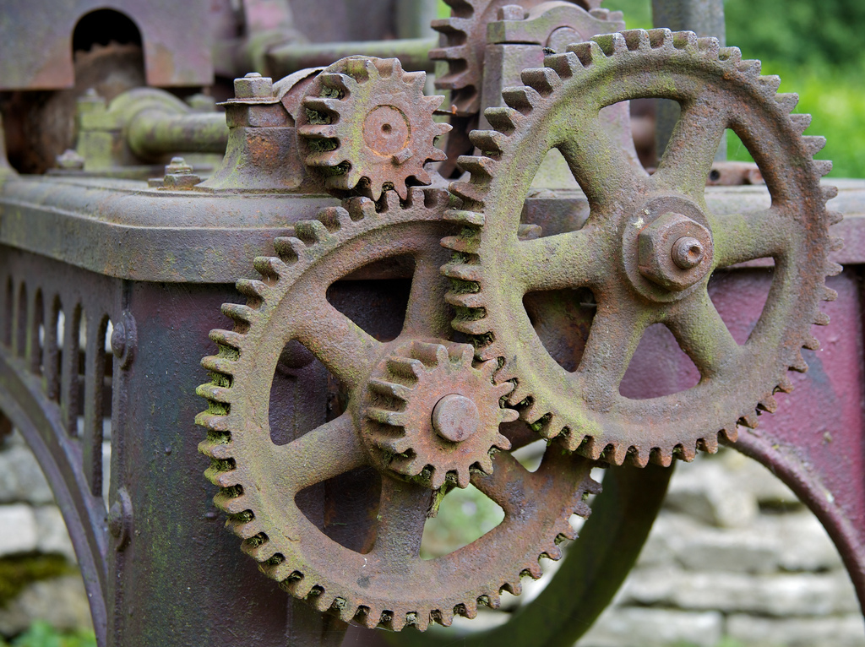
A gear.
Photo courtesy of BinaryApe (@flickr.com) - granted under creative commons licence - attribution

Slide 15
Plenary
Which mechanism would be most suited to these jobs?
C
Making a heavy sack easier to lift.

Slide 16
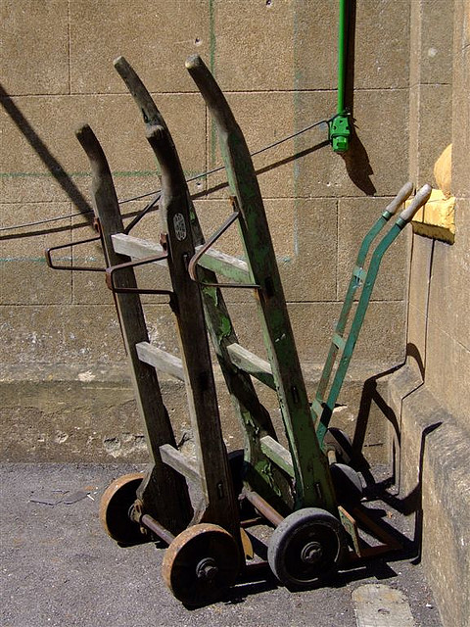
A lever.
Photo courtesy of Elsie esq. (@flickr.com) - granted under creative commons licence - attribution

